Slide 1
Service as a Catalyst for Minnesota Literacy. ServeMinnesota’s Bridge2Read
Senate Education & Policy Committee
February 9, 2022

Slide 2
ServeMinnesota
ServeMinnesota moves research to practice, using evidence-based approaches and the power of AmeriCorps to meet critical needs in our state.

Slide 3
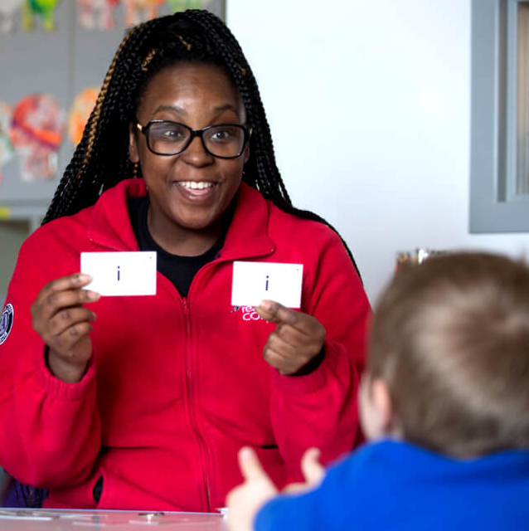
Reading Corps
ServeMinnesota
AmeriCorps people power working
on reading skills with thousands of
students at 600 partnering sites
across Minnesota.

Slide 4
Reading Corps: A Growing Evidence Base
Recognized nationally as a top literacy program, proven to provide the greatest promise of impact. --ProvenTutoring.org
PreK
Outperformed their peers on the five key measures of early literacy – Picture Names, Rhyming, Alliteration, Letter Sounds, and Letter Names.
Kindergarten
Correctly identified nearly 11 more letter sounds in one minute after one semester.
First Grade
Achieved significantly higher reading scores after one semester.
Second and Third Grade
Attained significantly higher oral reading fluency scores.
Two highly rigorous, impartial and complementary studies show Reading Corps conclusively improves early reading skills for struggling students, the equivalent of a half year to almost a full year of extra school.*
* Evaluations by NORC at the University of Chicago

Slide 5
Taking Reading Corps to the Next Level: Bridge2Read
ServeMinnesota Innovation
Reading Corps provides the literacy tools and coaching to support K-3 teachers!
Directly complements LETRS
Launched at 5 Reading Corps schools
Targets foundational reading skills
Compliments school’s already chosen reading curriculum
Translating reading science into classroom instructional tools that benefit all students.

Slide 6
ServeMinnesota Innovation
Why Reading Corps and Bridge2Read?
Supports K-3 teachers with reading practices based on Science of Reading.
Supports K-3 teachers transfer their new knowledge from LETRS Professional Development program into their daily classroom reading instruction.
Notes:
Two big reasons for creating B2R. One reason is that ServeMN wanted to support best impact of LETRS training. For our veteran teachers in districts with strong core curriculum for reading, they will find the application of their new LETRS knowledge readily applicable and actionable. However, for "other" teachers in districts using reading curriculum in the balanced literacy category… these "other" teachers, especially if they are new to teaching, will have a more challenging task translating their new LETRS knowledge into meaningful reading instruction so ServeMN created B2R to support these hard working K-3 teachers.

Slide 7
Bridge2Read Lesson Materials
aw
The letters ‘aw’ make the /aw/ sound at the end of this word: straw (point at ‘aw’ in straw).
Students practice with decodable sentences:
I like to drink milk with a straw.
The speed limit is a valid law that helps us drive our cars safely.
I like to draw in art class.
On the raw winter day, the sharp claws of the hawk grab the tree branch.
In the monsoon, five feet of rain fell and we had to withdraw into our safe homes with sunshine as the outlook for next month.
straw

Slide 8
Bridge2Read: Teachers Chime In
“Bridge2Read is immensely helping my reading instruction. It takes what I have learned through LETRS and directly applies it.”
“I have seen tremendous growth in both students' reading and spelling.”
“I love this program. It has tremendously changed the way I teach reading and it is super successful for all students.”

Slide 9
ServeMN & Higher Education Literacy Partnership
HELP:
Information network for higher education professors and teachers

Slide 10
Catalyst for Reading Achievement: Reading Corps Bridge2Read & LTRS
ServeMinnesota
Questions:
David Parker, Vice President Research & Development
Susan Thomson, ServeMN Senior Strategic Analyst

