Slide 1
Math Corps
A Strategic Initiative of ServeMinnesota.
March 2022

Slide 2

Who We Are.
ServeMinnesota is Minnesota’s Commission
on National and Community Service.
Administer and leverage federal AmeriCorps funding
Offer life-changing national service opportunities to thousands of individuals.
Focus on education, safe & affordable housing, employment, recovery from substance use disorder, the environment and now public health.

Slide 3



Making an Impact
Blending the People Power of AmeriCorps with the Science of What Works
SCIENCE
SERVICE
Data-Driven
Decision Making
Empirical Research
Implementation Fidelity
Culturally Relevant
The Power of AmeriCorps
Real Positive Impact

Slide 4
Domains of Educational Innovation
50,000 Students
Better at Math
500,000 Students
Better at Reading
Future Teachers
Solving the Teacher Shortage
Students/Adults Everywhere
Improve Education
Math
Reading
Teacher Pipeline
Research & Practice
Early Numeracy
K-3 Math
4-8 Math
Math Facts
K-3 Reading
Paired tutoring
Early Literacy
Tier 1 Instruction
Bridge2Read
Career Pathways
Representative Teachers
Equitable Instruction and Relationships
Data-based decision-making
Maintaining Intervention Success
And more!

Slide 5
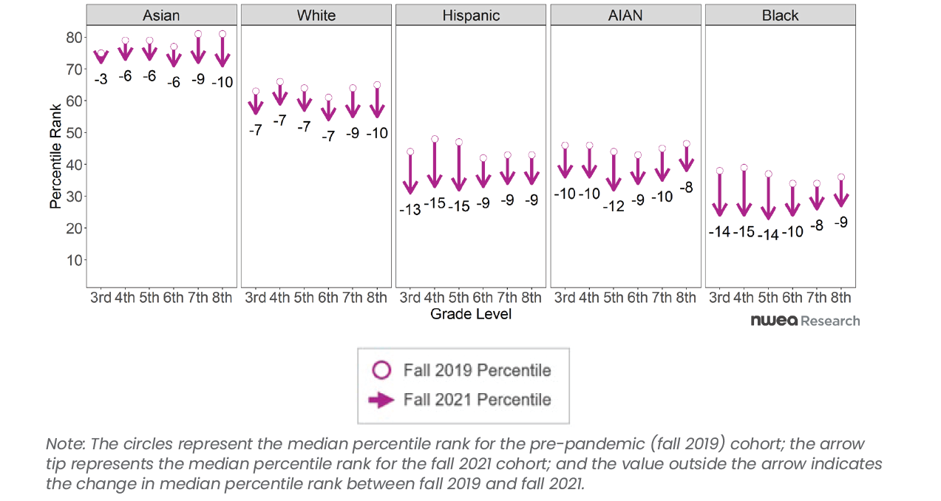
Math Scores Before and During the Pandemic
Lewis, K., & Kuhfeld, M. (2021). Learning during COVID-19: An update on student achievement and growth at the start of the 2021-22 school year. Portland, OR: NWEA Center for School and Student Progress.

Slide 6
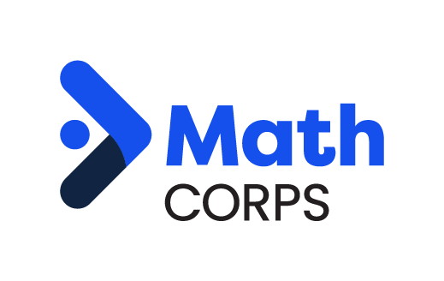
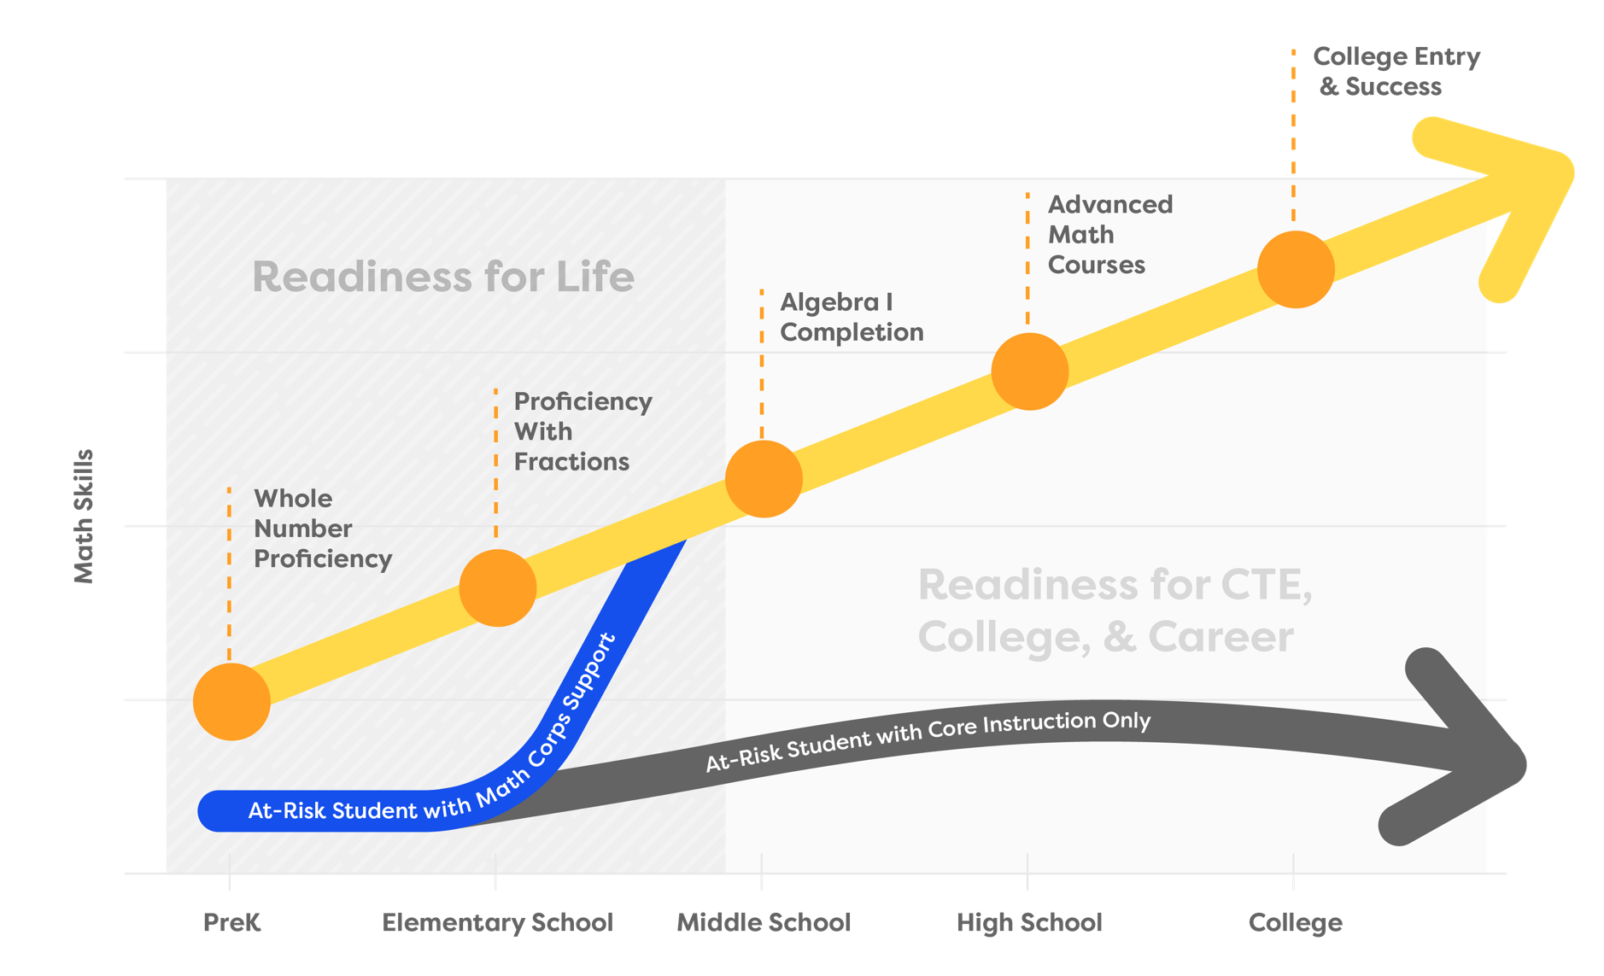
Why Math Corps?
Readiness for Academic
and Career Success
Supporting Students
Age 3 - Grade 8

Slide 7
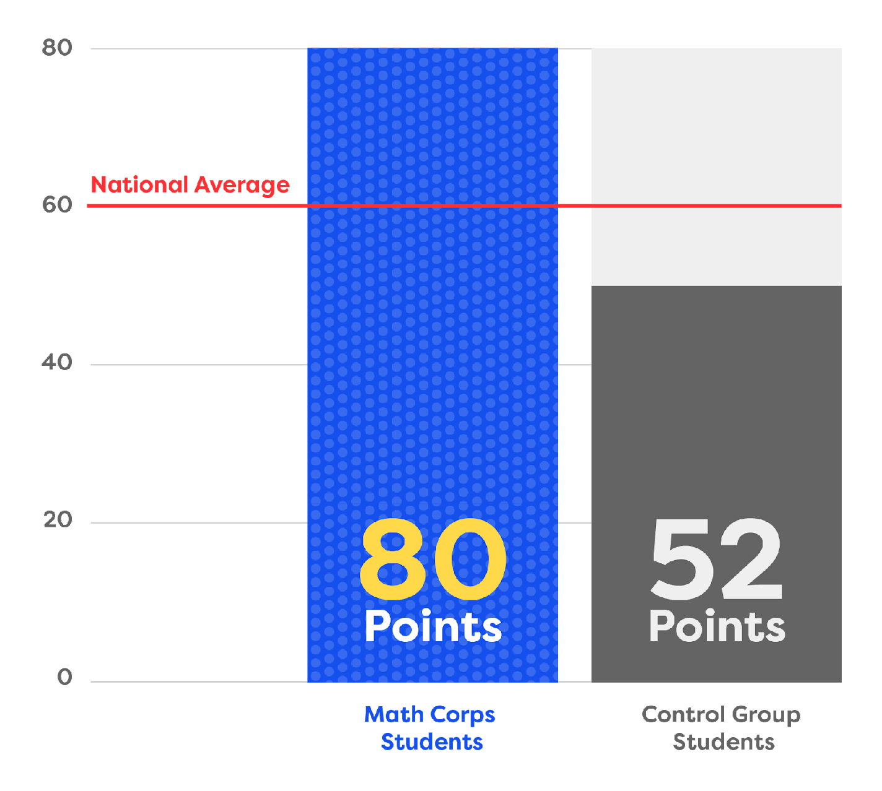


Star Math Growth
Math Corps students outperform national average growth
scoring 28 points higher
than the comparison group.

Slide 8
Math
Recent Recognition
Math Corps won the F. M. Kirby Prize for Scaling Social Impact, an international competition. The Kirby Prize comes through the Fuqua School of Business at Duke University.
                $100,000 prize which will be used toward creation of an assessment for grades 4-8 that more closely aligns with the skills Math Corps addresses.
Math Corps and Reading Corps were recognized by the Annenberg Institute's National Student Support Accelerator as proven high dosage tutoring programs that are effective and replicable.

Slide 9
PreK-Grade 8 Math
Math
Early Numeracy
K-3 Math
4-8 Math
Integrated evidence-based numeracy learning activities into the former PreK Reading Program – now called Early Learning Corps.
Why:
Early numeracy is a foundation for future learning (even beyond math).
AmeriCorps in PreK settings are perfectly positioned to supported early numeracy development
Brand new AmeriCorps program to provide K-3 Math tutoring.
Why:
Students who have a strong foundation in working with whole and rational numbers are better prepared for algebra.
AmeriCorps members make great tutors.
A scaled and sustainable evidence-based math tutoring program.
Why:
Students who have a strong foundation in working with whole and rational numbers are better prepared for algebra.
AmeriCorps members make great tutors.

Slide 10
Math Corps
A Strategic Initiative of ServeMinnesota.
Sandra Pulles, Ph.D. – sandy@serveminnesota.org

