Slide 1
Working Together for Transit Solutions
SENATE TRANSPORTATION COMMITTEE February 16, 2021

Slide 2
Suburbs sought legislation in 1982 to create transit agencies to serve fast-growing areas that were paying for transit but not being served.
Funding Changes over the years: Property Tax-MVST.
Legislative Auditor Report
“Suburban transit agencies are productive contributors to the region and have developed close relationships with member communities.”
HISTORY
Notes:
Why suburban transit. The Legislative Auditor determined that suburban transit agencies have established
themselves as productive contributors to the regional transit system and have developed
close relationships with the communities they serve. Suburban transit agencies have been
known for their innovations and the Legislative Auditor highlighted our pilot tests of new
approaches and technologies.

Slide 3
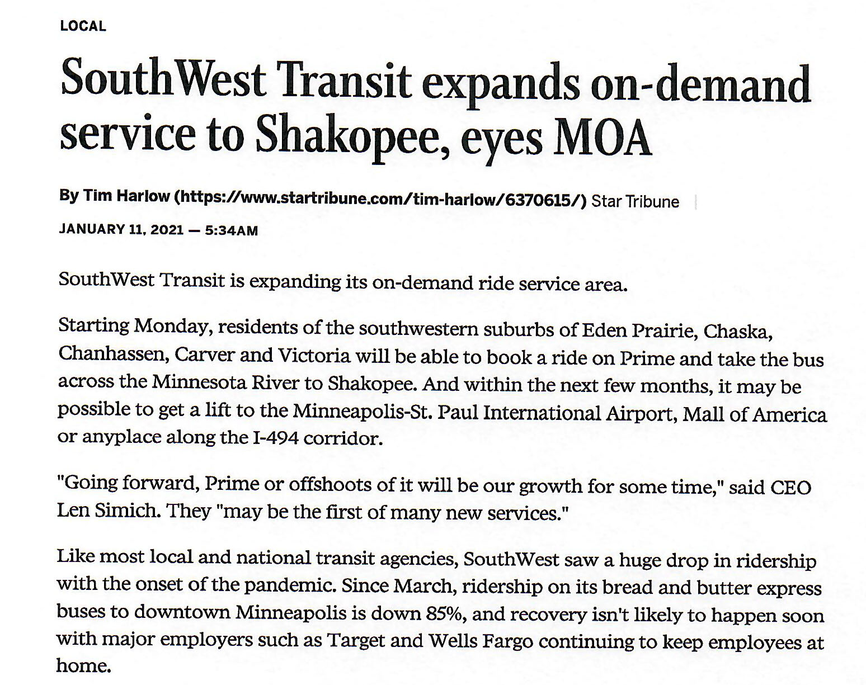
HALLMARKS OF SUCCESS
Innovation, customer service and cost effectiveness are the hallmarks of our success.
-Suburban Providers have customer satisfaction rankings of 95% or better.
-Suburban Providers operate the region’s longest routes, and have the most effective “cost per passenger mile” in the region.
-Suburban Providers have received numerous awards for their innovation and were the first to bring the region:
Coach Buses
Transit Oriented Development
Real-time phone/computer apps
WiFi on Vehicles and in Stations
Micro Transit Operations
Innovative Suburb to Suburb Service (Rt. 495, Prime and Prime MD)
Public Private Partnerships
Notes:
Maple Grove: During the pandemic, we also expanded our service to two food shelve locations outside the City of Maple Grove for no cost and we also will pick up grocery orders at local MG stores and bring them to the homes of seniors at no cost.

Slide 4
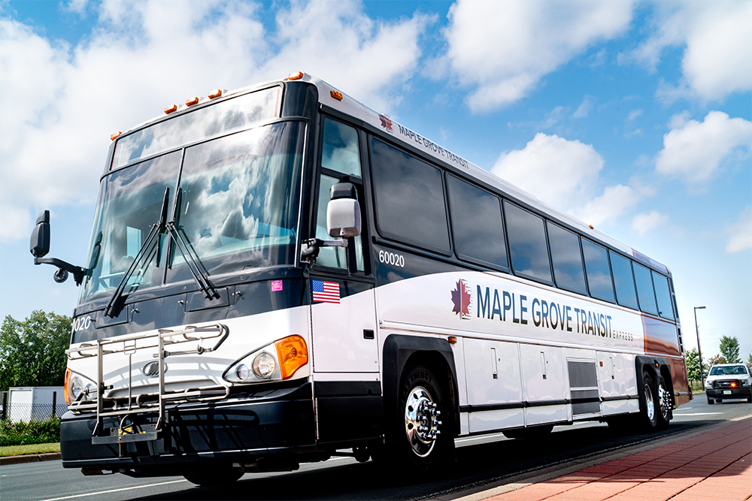
MISREPRESENTATIONS
Express ridership not coming back
Suburban providers only serve choice riders
Long-haul ridership not as important
STA Facts
31%: households with 0-1 vehicles*
70%: Demand-response riders fall under the poverty line
90%: Suburban riders plan to use public transportation post-pandemic
(Source: American Community Survey 5-year; 2015-2019)
Notes:
• Employment lifeline – Connecting customers to employment centers in suburban
communities and the downtown areas is a top priority of suburban transit agencies.
Suburban transit agencies have the longest-serving reverse commutes, which have
connected residents in the core cities, including Cedar Riverside, to jobs in the
suburbs. According to Metropolitan forecasts, more new jobs are expected to be
located in suburban areas than the urban core in the next 30 years.

Slide 5
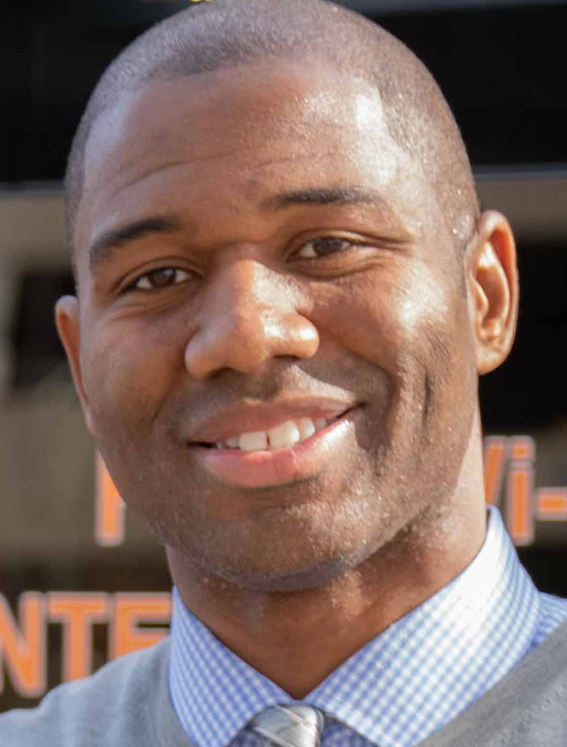
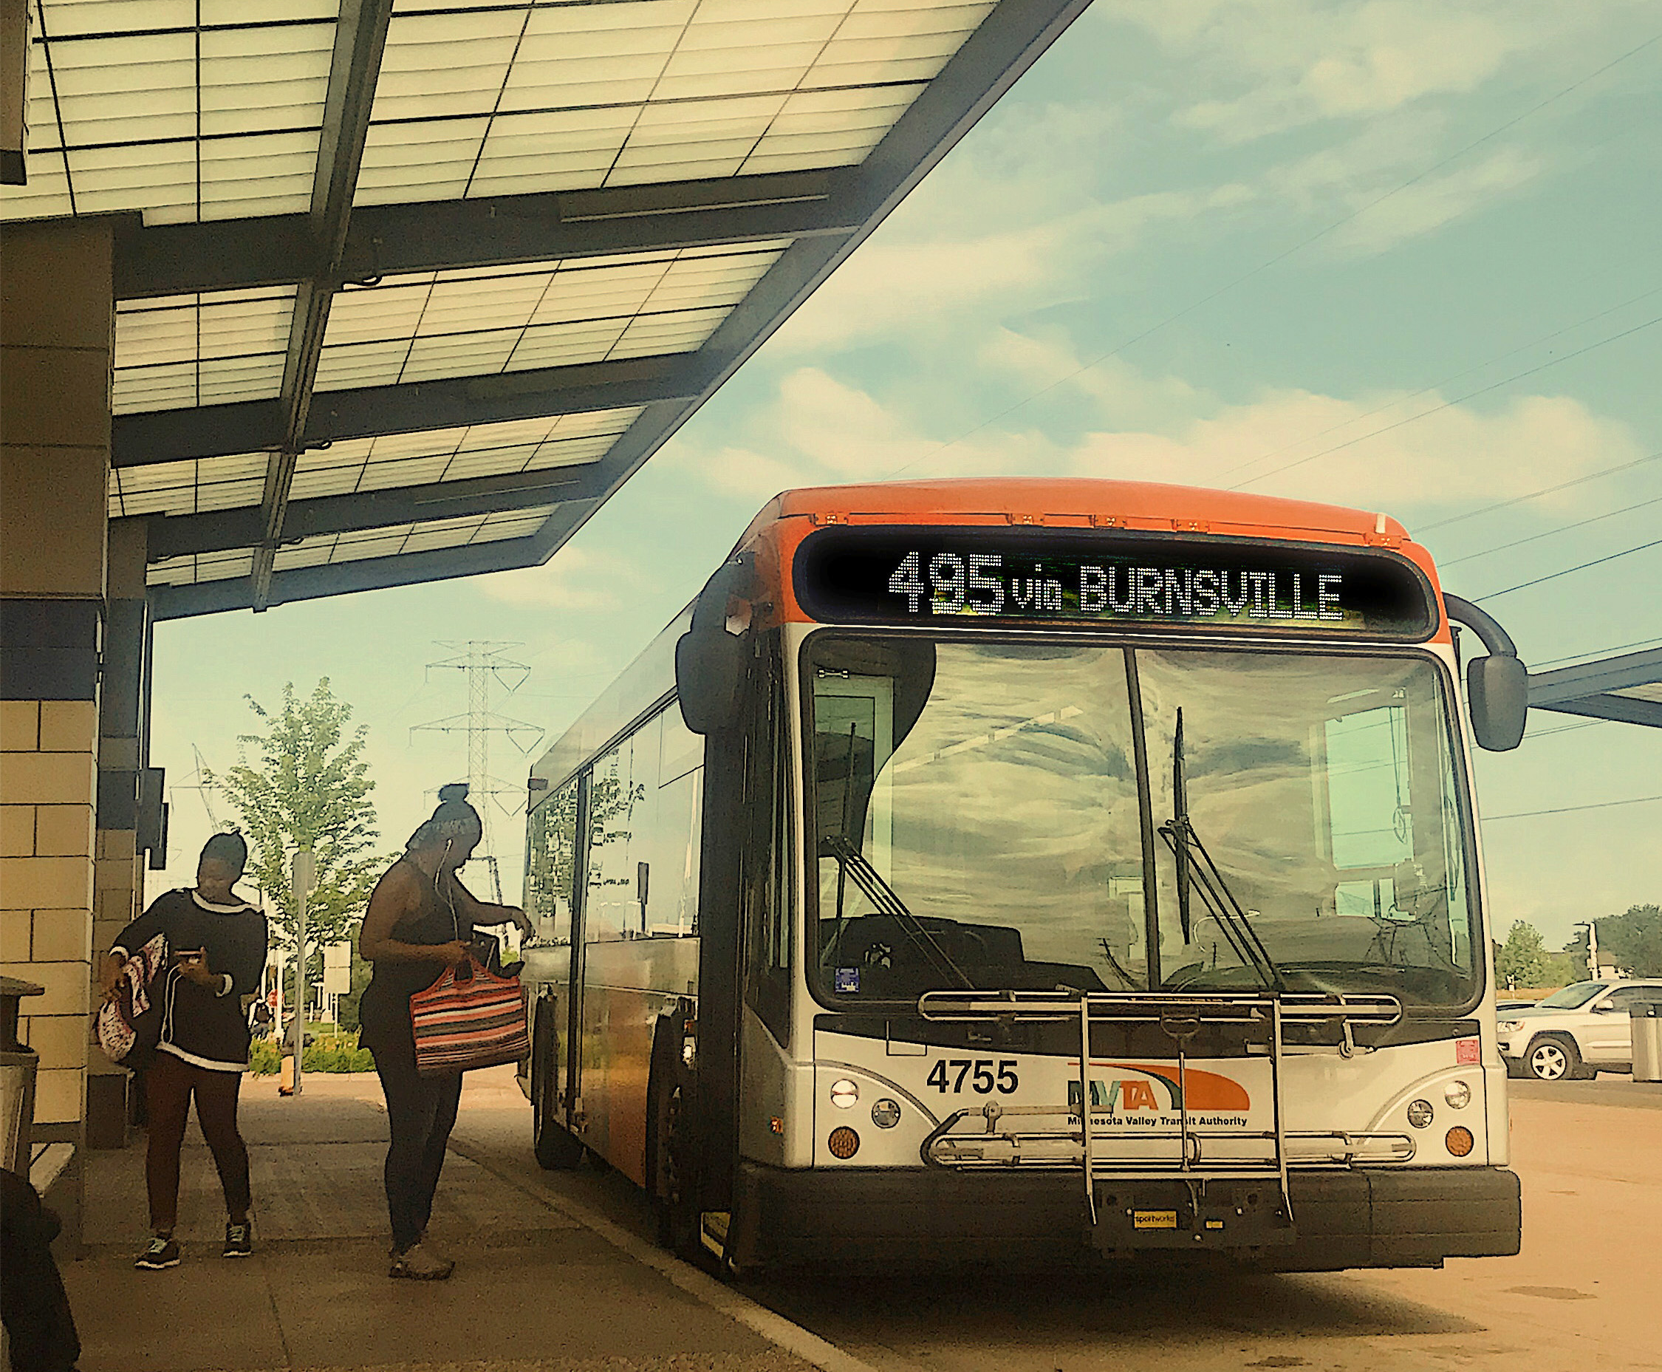
COVID-19 AND CARES FUNDING
Ridership – During pandemic, suburban local routes had highest ridership in region.
Safety – STA has led the way exceeding CDC standards.
Right-sizing – Adjusted staffing in response to temporary express ridership decline.
Food delivery – to transit dependents and individuals struggling financially.
Transportation – for COVID testing and vaccinations.

Slide 6
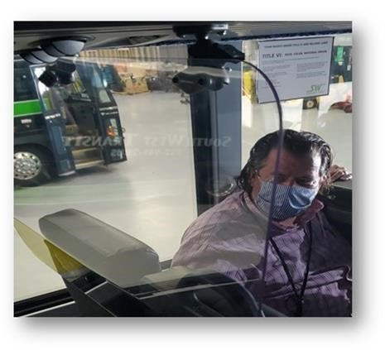
COVID-19 AND CARES FUNDING
The first CARES Act Distribution was primarily used to maintain Service and Operations to offset the loss in fare revenue, ridership and maintain passenger safety. Other actions funded with non-CARES funding included:
Enhanced cleaning and sanitation
Bus barriers to protect staff and public
Improved air filtration systems in facilities and buses

Slide 7
GROWTH POTENTIAL
TO SERVE ECONOMY
STA Connects to Region
Example: Passengers from 31 different cities across Minnesota use Maple Grove Transit.
MVTA serves customers from more than 95 cities in the region

Slide 8
2021 LEGISLATIVE PRIORITIES
Priority 1. Maintain Existing Funding Model (MVST and Reserves at current percentages) as economy stabilizes from pandemic.
Preservation of existing regionwide transportation network is essential as COVID vaccine rolls out and travel patterns return.
CARES 2 Funding is critical to maintaining service for transit-dependent riders and preserving first/last mile connections.
Notes:
Acronyms. While suburban ridership has grown from 1 million passengers per year to more than 5
million passengers per year since the creation of the suburban transit agencies,
funding equity has remained an ongoing concern. A 2016 analysis by the Suburban
Transit Association found that suburban communities were contributing more than 10
percent to the MVST funding formula but only receiving back under 4 percent of their
contribution.

Slide 9
2021 LEGISLATIVE PRIORITIES
Priority 2. Suburbs are growing.
Public investment should follow this trend.
Investment should be equitably targeted for all forms of transit -- local, express, reverse commute and microtransit services.
It’s critical to maintain funding for existing services prior to adding or expanding new initiatives.
Notes:
A 2016 analysis found suburban communities were contributing more than 10 percent MVST funding formula but only receiving back under 4 percent of their contribution.

Slide 10
2021 LEGISLATIVE PRIORITIES
Priority 3. Provide more flexibility to suburban providers and more equitable oversight
The MPO is also the regions largest operator which unfortunately has created unhealthy competition as well as a conflict of interest, limiting opportunities for equitable funding, collaboration, and overall accountability.
The STA members should become Direct Recipients for federal funding like similar-sized transit providers around the state, and have the ability to set:
Fare Policy - Allow STA members to set appropriate fares based on distance
Fleet Replacement – Ensure STA stake in vehicle ownership and replacement

Slide 11
SUBURBAN TRANSIT ASSOCIATION CONTACTS
Kevin Burkart, STA chair: kburkart@cityofpriorlake.com or (952) 457-8066
Mike Huang, STA vice chair: mhuang@chaskamn.com or 952-393-3723
Mike Opatz, Maple Grove Transit: mopatz@maplegrovemn.gov or (763) 494-6005
Luther Wynder, Minnesota Valley Transit Authority: lwynder@mvta.com or (952) 882-7501
Len Simich, SouthWest Transit: lensimich@swtransit.org or (952) 974-3110
Laurie Hokkanen, Plymouth Metrolink: lhokkanen@plymouthmn.gov or (763) 509-5300
Government Relations:
James Clark, Messerli & Kramer: jclark@messerlikramer.com or (651) 343-3032
Courtney Jasper, Messerli & Kramer: cjasper@MesserliKramer.com or (651) 556-9203
Sherry Munyon, Capitol Access: smunyon@capitolaccess.us or (612) 723-4245

