Slide 1
Foundation for Excellence in Education
Transforming education to unlock lifelong opportunity and success every child.
Minnesota: The Achievement Gap
Senate Education Committee meeting in 1100 Senate Office Building
3:00 pm on Monday, February 17, 2020
Christy Hovanetz, Ph.D.
Senior Policy Fellow

Slide 2

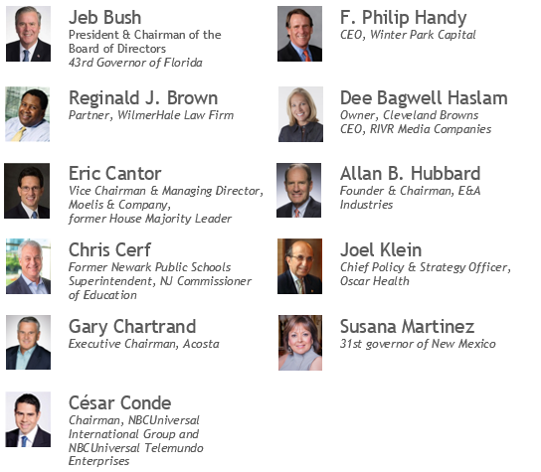
Foundation for Excellence in Education
Our c3 Board of Directors
501(c)(3) organization that supports state leaders in transforming education to unlock opportunity and lifelong success for each and every child.
Focused on educational opportunity, innovation and quality, ExcelinEd’s agenda is increasing student learning, advancing equity and readying graduates for college and career.

Slide 3
Achievement gaps are not defensible
All children can learn, but unacceptably achievement gaps persist.
Analyzing and calculating gaps is challenging.
Thoughtful analysis of achievement gap data in context creates better policy solutions and identifies model states for best practices.
Achievement gap: the difference in the average scores or proficiency rates for the two groups of students (Examples, White-Black, High Income-Low Income, Female-Male).
Percent Proficient: Percent of students scoring at the achievement levels indicating a mastery of grade level knowledge and skills.
Average Scale Score: The average of scores students earned representation of the total number of correct answers converted onto a standardized scale.

Slide 4
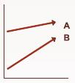
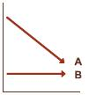




Ways the achievement gap narrows
Only one way to narrow the gap is good for all students.
The average scores of both groups increase, while the score of the lower performing group increases even more. The average score of the higher performing group does not change, while the score of the lower performing group increases. The average score of the higher performing group declines, while the score of the lower performing group increases.
The average score of the higher performing group declines, while the score of the lower performing group does not change. The average scores of both groups decline, but the score of the higher performing group declines even more. The average scores of both groups do not change significantly, but the combined effect causes a narrowing of the gap.
Notes:
NCES, The Nation's Report Card https://nces.ed.gov/nationsreportcard/studies/gaps/understand_gaps.aspx

Slide 5
Minnesota Comprehensive Assessments-III
Annual reading and math tests and reporting student performance is required by federal law.
Minnesota Comprehensive Assessments (MCA-III) are the annual statewide tests that measure student progress toward Minnesota's academic standards.
All public school students take a reading and math test in grades 3-8 and high school.
MCA-III reports results as percent of students by the four achievement levels (Does Not Meet, Partially Meets, Meets, and Exceeds) and scale scores.
Results are reported by student, student groups, school, district and state.
Performance on the MCA-III is not comparable to other state tests because the standards, items, and expectations differ.

Slide 6
National Assessment of Educational Progress (NAEP)
State participation in NAEP is required by federal law.
With the passage of No Child Left Behind of 2001, states receiving Title I funding are required to participate in NAEP reading and mathematics at grades 4 and 8 every two years.
NAEP is administered to a sample of students who represent the student population of the nation, states, and some districts. NAEP is not designed to report results for individual students or schools.
NAEP reports results as percent of students by achievement level (Below Basic, Basic, Proficient and Advanced) and Scale Scores.
Results are reported by student groups, not all states have reportable results for all student groups.
NAEP is the only objective student learning outcome measure available for apples-to-apples state comparisons.

Slide 7
Proficiency and achievement gaps
Comparing proficiency and achievement gaps on the MCA-III and NAEP.
Minnesota 2019 MCA-III vs NAEP Proficiency Gap | Reading Grade 4 | Reading Grade 8 | Math Grade 4 | Math Grade 8
2019 MCA-III Meets and Exceeds | 55% | 58% | 64% | 55%
2019 NAEP Proficient and Advanced | 38% | 34% | 52% | 44%
NAEP difference from MCA-III Proficiency | -17% | -23% | -11% | -10%
Minnesota 2019 MCA-III White-Black Achievement Gap | Reading Grade 4 | Reading Grade 8 | Math Grade 4 | Math Grade 8
White Students 2019 MCA-III Proficient & Above | 65% | 65% | 75% | 64%
Black Students 2019 MCA-III Proficient & Above | 30% | 32% | 34% | 25%
White-Black Achievement Gap MCA-III Proficiency | 35% | 33% | 40% | 38%
Minnesota 2019 NAEP White-Black Achievement Gap | Reading Grade 4 | Reading Grade 8 | Math Grade 4 | Math Grade 8
White Students 2019 NAEP Proficient & Above | 46% | 41% | 65% | 53%
Black Students 2019 NAEP Proficient & Above | 19% | 11% | 26% | 14%
White-Black Achievement Gap NAEP Proficiency | 26% | 30% | 39% | 39%
Notes:
http://profiles.doe.mass.edu/mcas/achievement_level.aspx?linkid=32&orgcode=00000000&orgtypecode=0&
http:
https://www.nationsreportcard.gov/

Slide 8
Student proficiency on MCA-III is declining
Since 2015, math proficiency has declined 5.3 percentage points.
Notes:
https://rc.education.mn.gov/#assessmentsParticipation/orgId--999999000000__groupType--state__test--MCA-III__subject--R__accountabilityFlg--FOC_NONE__year--trend__grade--all__p--8882

Slide 9
Student proficiency on MCA-III Math is declining
Over the last five years, the math achievement gap has widened by 2.1 percentage points in grade 4 and 1.4 percentage points in grade 8.
Minnesota Report Card
Notes:
https://rc.education.mn.gov/#assessmentsParticipation/orgId--999999000000__groupType--state__test--MCA-III__subject--M__accountabilityFlg--FOC_NONE__year--trend__grade--04__categories--white__p--8882

Slide 10
Student proficiency on MCA-III Reading is declining in grade 4 and increasing in grade 8
Over the last five years, the reading achievement gap has widened by 0.5 percentage point in grade 4 and narrowed by 0.9 percentage point in grade 8.
Minnesota Report Card

Slide 11
MCA-III number and percent proficient
Understanding the numbers makes this obligation reasonable.
Math MCA-III 2019 | Percent proficient | Number tested | Number proficient | Number not proficient
White Grade 4 | 74.6% | 41,024 | 30,624 | 10,400
White Grade 8 | 63.6% | 42,428 | 26,967 | 15,461
Black Grade 4 | 34.2% | 7,222 | 2,471 | 4,751
Black Grade 8 | 25.2% | 6,640 | 1,670 | 4,970
Reading MCA-III 2019 | Percent proficient | Number tested | Number proficient | Number not proficient
White Grade 4 | 65.3% | 41,015 | 26,792 | 14,223
White Grade 8 | 65.4% | 42,572 | 27,825 | 14,747
Black Grade 4 | 30.2% | 7,233 | 2,181 | 5,052
Black Grade 8 | 32.2% | 6,673 | 2,150 | 4,523
To close the White-Black achievement gap:
only 2,917 more black 4th graders and 2,553 black 8th graders Statewide need to reach to math proficiency.
only 2,542 more black 4th graders and 2,214 black 8th graders Statewide need to reach reading proficiency.
But, is that good enough for Minnesota?

Slide 12
Student proficiency in grade 3 MCA-III Reading is declining
Minnesota narrowed the White-Black achievement gap by 5.7 percentage points since 2015.
Notes:
https://rc.education.mn.gov/#assessmentsParticipation/orgId--999999000000__groupType--state__test--MCA-III__subject--R__accountabilityFlg--FOC_NONE__year--trend__grade--03__categories--black__p--8882

Slide 13
Student proficiency in grade 3 MCA-III Reading is declining
Minnesota narrowed the White-Black achievement gap by 5.7 percentage points since 2015, but this is bad gap closure mainly due declining proficicncy of white students.

Slide 14
Achievement gaps
Which state is better?
State 1 has a White-Black achievement gap of 31 points in grade 4 NAEP Math.
State 2 has a White-Black achievement gap of 14 points in grade 4 NAEP Math.

Slide 15
Achievement gaps
Which state is better?
Minnesota has a White-Black achievement gap of 31 points in grade 4 NAEP Math.
West Virginia has a White-Black achievement gap of 14 points in grade 4 NAEP Math.
2019 NAEP | Minnesota |  |  | West Virginia |  |  | National Public Average
Grade 4 Math | Scale Score | Rank | Gap | Scale Score | Rank | Gap | Scale Score | Gap
All Students | 248 | 1 |  | 231 | 48 |  | 240
White | 258 | 2 |  | 232 | 51 |  | 249
Black | 226 | 14 | 31 | 218 | 35 | 14 | 224 | 25
West Virginia has the worst white student performance in the country compared to Minnesota white students who rank second in the nation behind only DC white students.
Minnesota black students out perform West Virginia’s black students by 8 points, nearly a grade level.
In context, Minnesota’s 31 point gap is bad, but all students are better off in Minnesota than in West Virginia. Minnesota black students are better off than their peers in 36 other states and DC.
Context must not be used as an excuse or in defense of gaps. Understanding how students do compared to their peers provides context for state policy (don’t rely on WV for best practices).
Notes:
Seven states do not have a representative Black student group for NAEP reporting.

Slide 16
Minnesota NAEP Math performance trend
Minnesota has a top ranking for NAEP math performance, but this performance trend will jeopardize that top ranking.
Minnesota NAEP Grade 4 Math | 2013 | 2015 | 2017 | 2019 | Change 2013 to 2019
Scale Score | 253.4 | 249.6 | 248.8 | 248.4 | -5.01
Percent At or Above Basic | 90.1 | 87.2 | 86.0 | 85.3 | -4.7
Percent At or Above Proficient | 59.4 | 53.4 | 52.6 | 52.9 | -6.6
Minnesota NAEP Grade 8 Math | 2013 | 2015 | 2017 | 2019 | Change 2013 to 2019
Scale Score | 294.6 | 294.2 | 293.96 | 290.8 | -3.8
Percent At or Above Basic | 82.5 | 82.0 | 80.1 | 77.1 | -5.5
Percent At or Above Proficient | 47.2 | 47.8 | 46.4 | 44.2 | -3
Source: The Nation’s Report Card

Slide 17
Minnesota NAEP Reading performance trend
Minnesota NAEP reading performance has been on a downward trend.
Minnesota NAEP Grade 4 Reading | 2013 | 2015 | 2017 | 2019 | Change 2013 to 2019
Scale Score | 227.0 | 223.4 | 224.5 | 222.4 | -4.6
Percent At or Above Basic | 74.0 | 70.7 | 71.4 | 69.3 | -4.8
Percent At or Above Proficient | 41.5 | 39.0 | 39.1 | 38.1 | -3.4
Minnesota NAEP Grade 4 Reading | 2013 | 2015 | 2017 | 2019 | Change 2013 to 2019
Scale Score | 271.0 | 270.2 | 268.6 | 263.8 | -7.2
Percent At or Above Basic | 81.7 | 81.2 | 78.6 | 74.0 | -7.8
Percent At or Above Proficient | 40.5 | 39.7 | 39.3 | 34.2 | -6.4
Source: The Nation’s Report Card

Slide 18
Context for state comparisons
ALL students can learn. No excuses.
2019 NAEP | Minnesota |  |  | Florida |  |  | Mississippi |  |  | National Public
Grade 4 Math | Scale Score | Rank | Gap | Scale Score | Rank | Gap | Scale Score | Rank | Gap | Scale Score | Gap
All Students | 248 | 1 |  | 246 | 4 |  | 241 | 23 |  | 240
White | 258 | 2 |  | 254 | 4 |  | 251 | 15 |  | 249
Black | 226 | 14 | 31 | 233 | 2 | 21 | 230 | 5 | 21 | 224 | 25
Hispanic | 224 | 43 | 34 | 242 | 2 | 12 | 244 | 1 | 7 | 231 | 18
FRL | 231 | 12 | 28 | 239 | 1 | 17 | 236 | 2 | 21 | 229 | 24
2019 NAEP | Minnesota |  |  | Florida |  |  | Mississippi |  |  | National Public
Grade 4 Read | Scale Score | Rank | Gap | Scale Score | Rank | Gap | Scale Score | Rank | Gap | Scale Score | Gap
All Students | 222 | 12 |  | 225 | 6 |  | 219 | 28 |  | 219
White | 231 | 15 |  | 233 | 9 |  | 230 | 19 |  | 229
Black | 201 | 22 | 30 | 211 | 4 | 23 | 209 | 7 | 21 | 203 | 26
Hispanic | 202 | 43 | 29 | 221 | 1 | 12 | 221 | 2 | 9 | 208 | 21
FRL | 205 | 40 | 29 | 216 | 1 | 22 | 215 | 3 | 24 | 207 | 28
 | Minnesota | Florida | Mississippi | West Virginia
Student Population | 875,021 | 2,816,791 | 483,150 | 273,855
Black | 11% | 22% | 49% | 4%
Hispanic | 9% | 32% | 4% | 2%
White | 67% | 39% | 44% | 90%
Free/Reduced Lunch | 38% | 58% | 75% | 45%
Per Pupil Expenditure | $ 12,364 | $ 9,176 | $ 8,692 | $ 11,424
Notes:
2016-17 Student Characteristic data: https://www.nationsreportcard.gov/profiles/stateprofile/overview/MN?cti=PgTab_Demographics&chort=1&sub=RED&sj=MN&cj=MS&fs=Grade&st=MN&year=2019R3&sg=Race%2FEthnicity%3A+White+vs.+Black&sgv=Difference&ts=Single+Year&tss=2019R3&sfj=NP

Slide 19
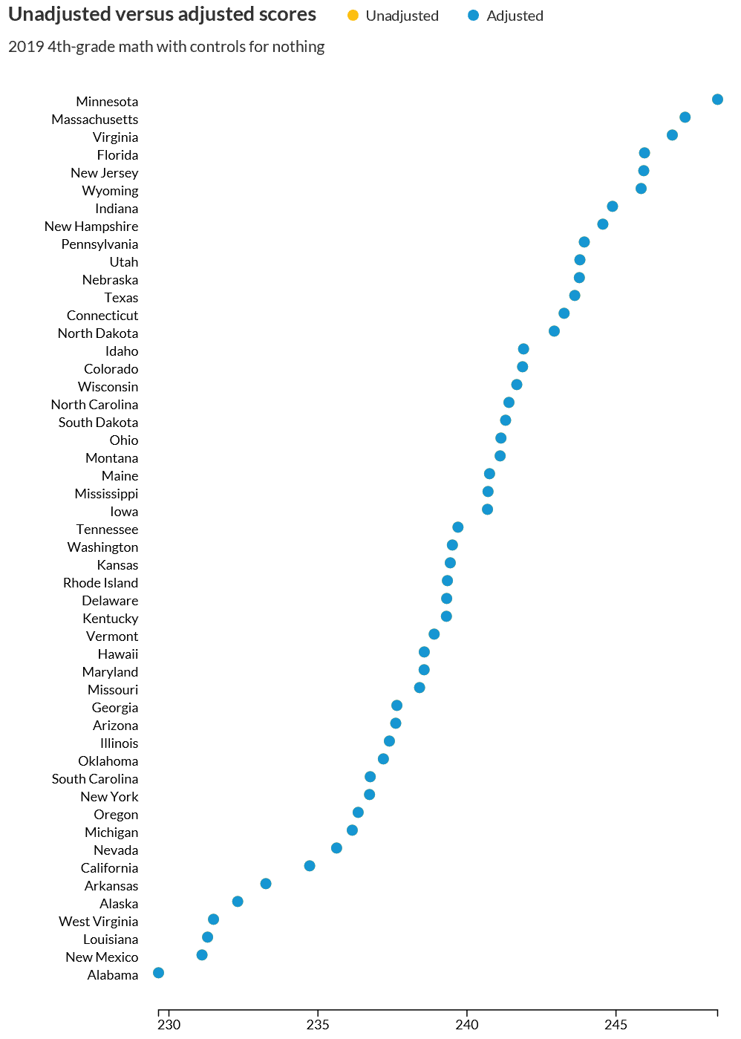
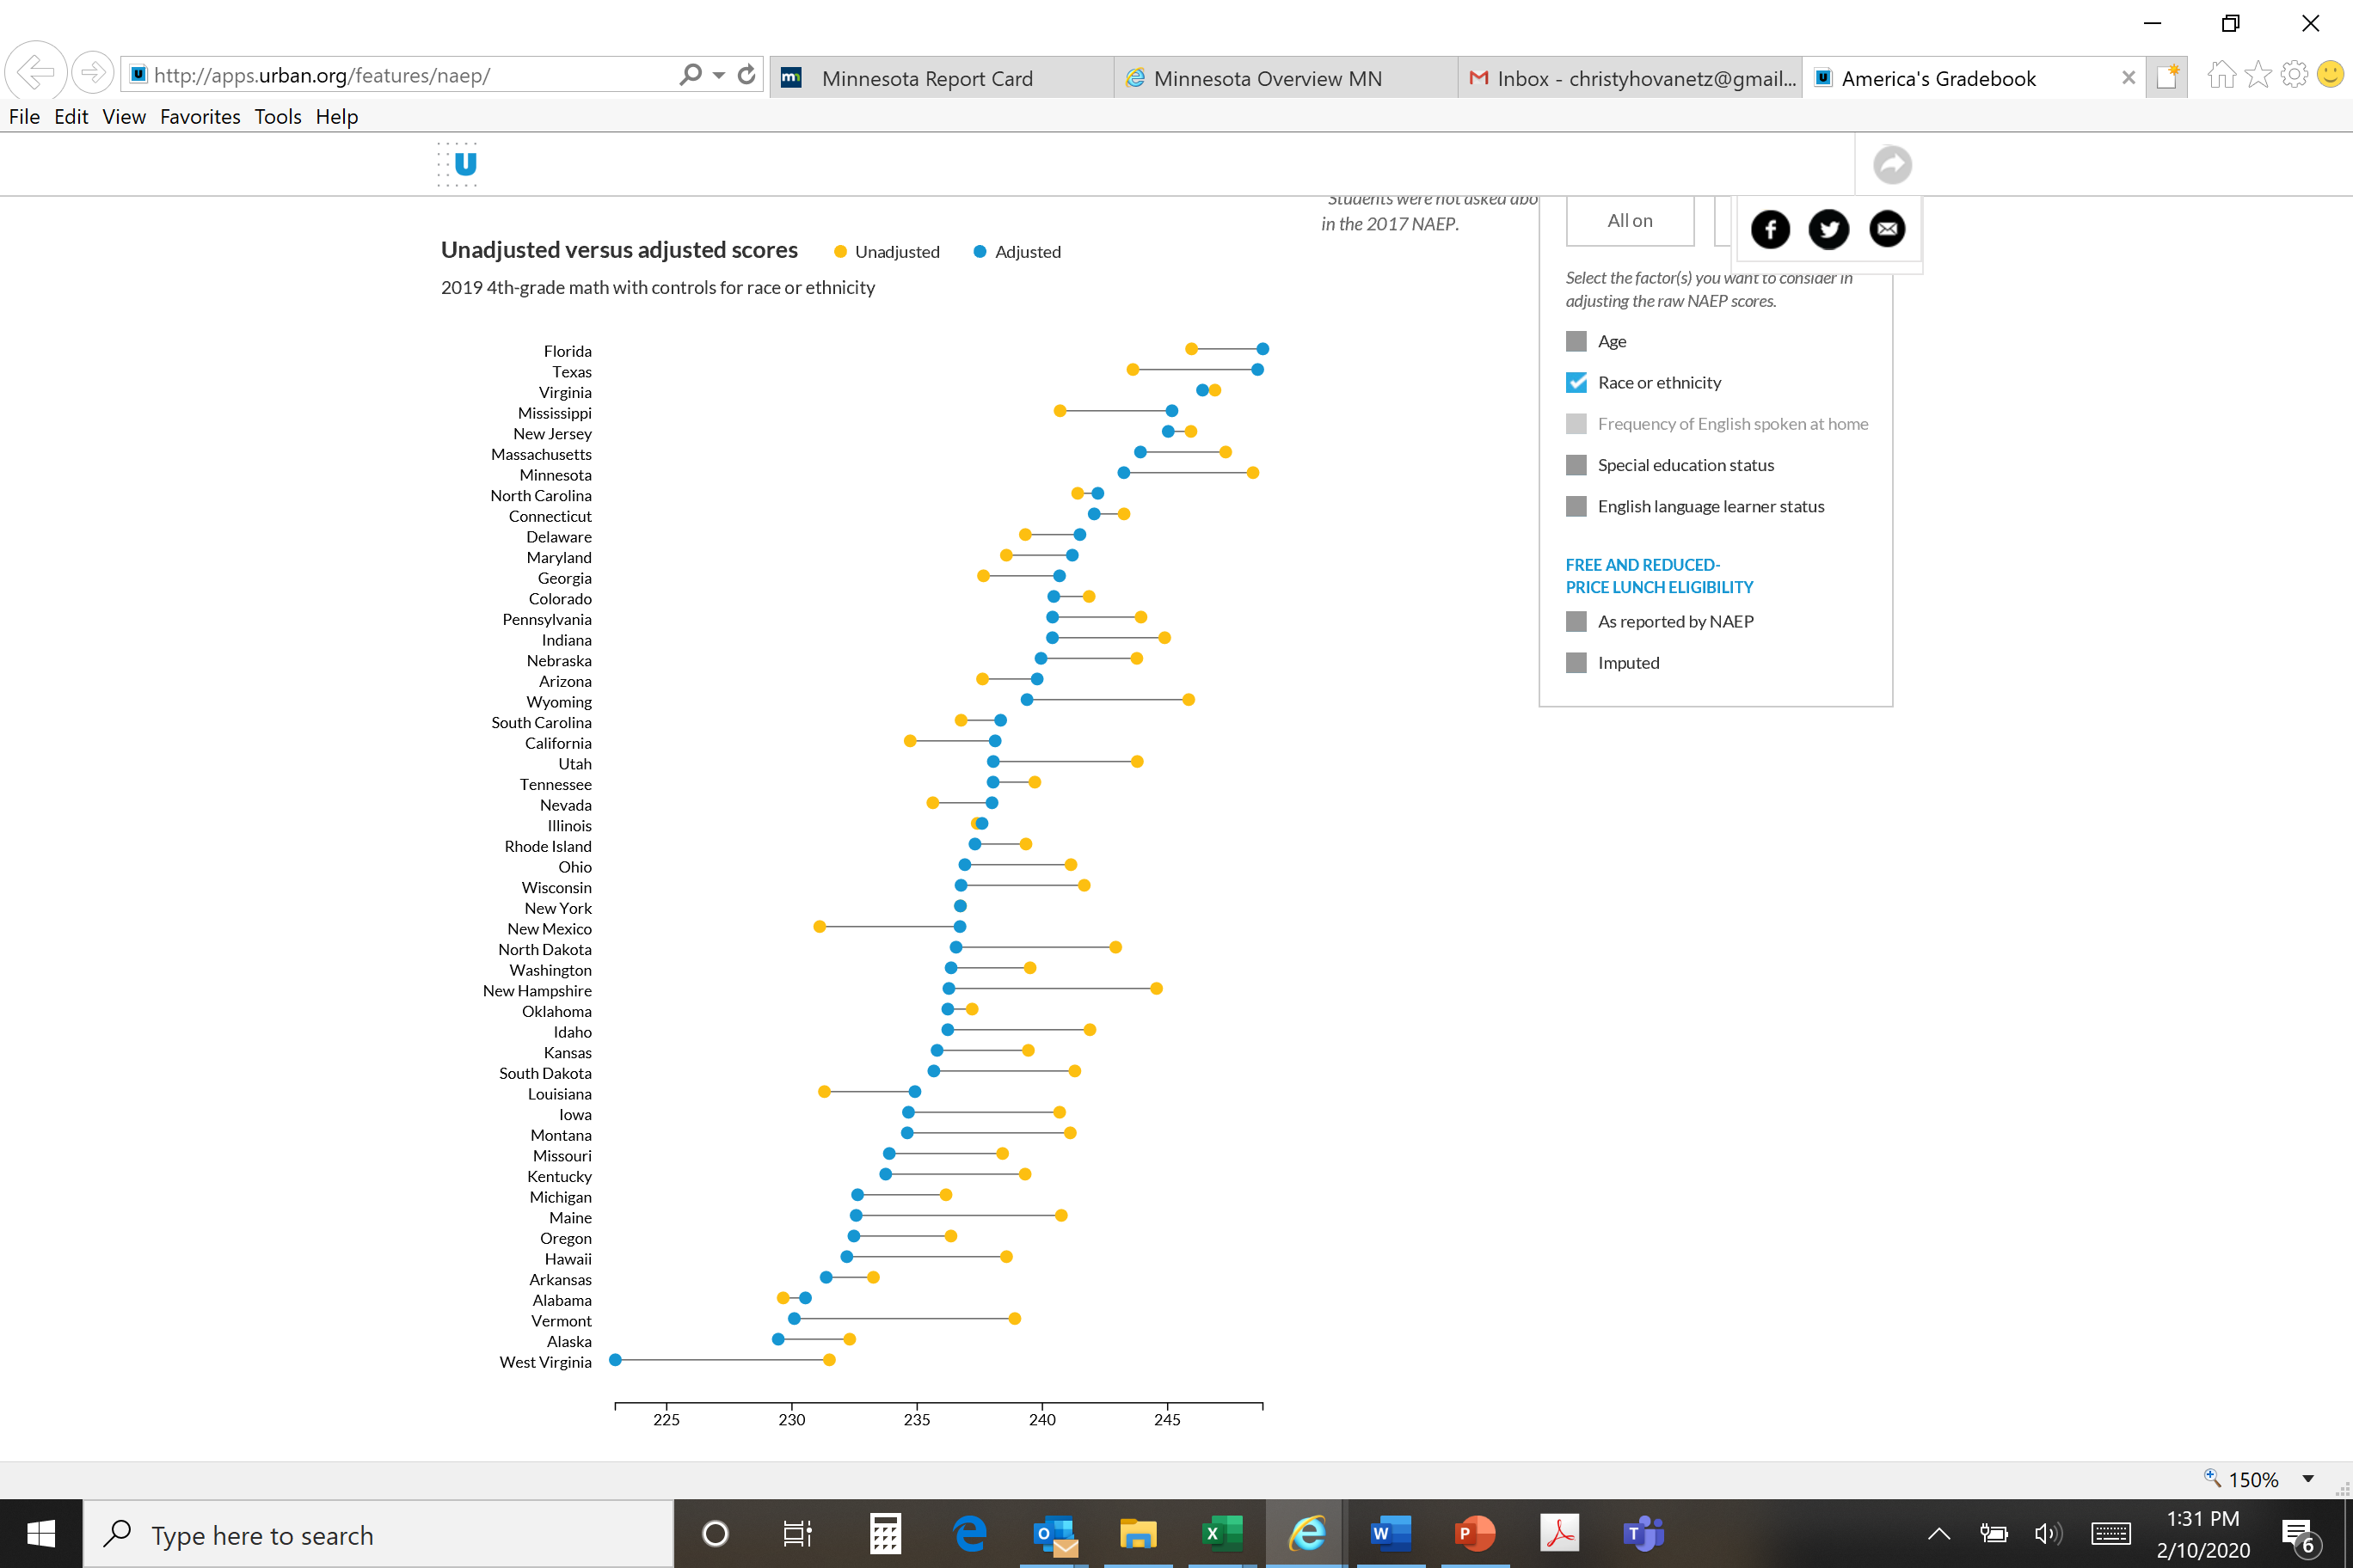
NAEP 2019 Grade 4 Math: Race Adjusted

Slide 20
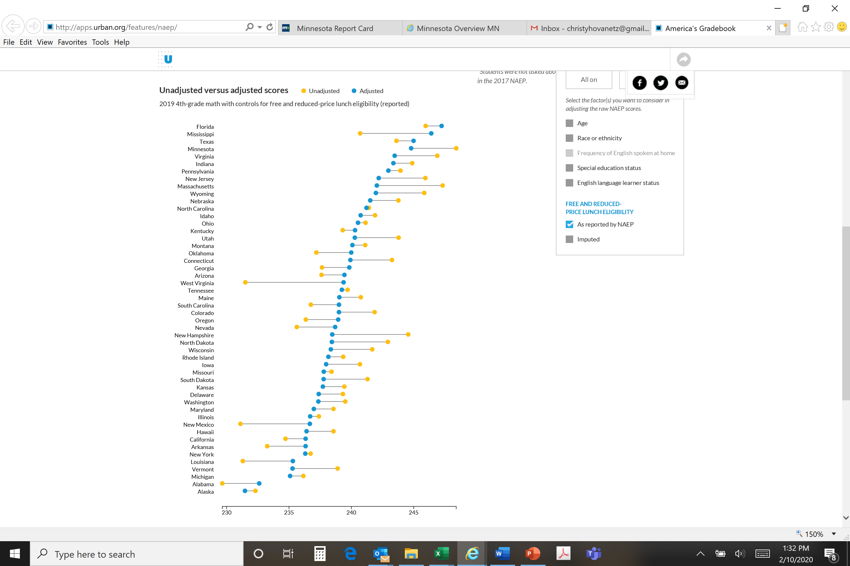
NAEP 2019 Grade 4 Math: Income Adjusted

Slide 21
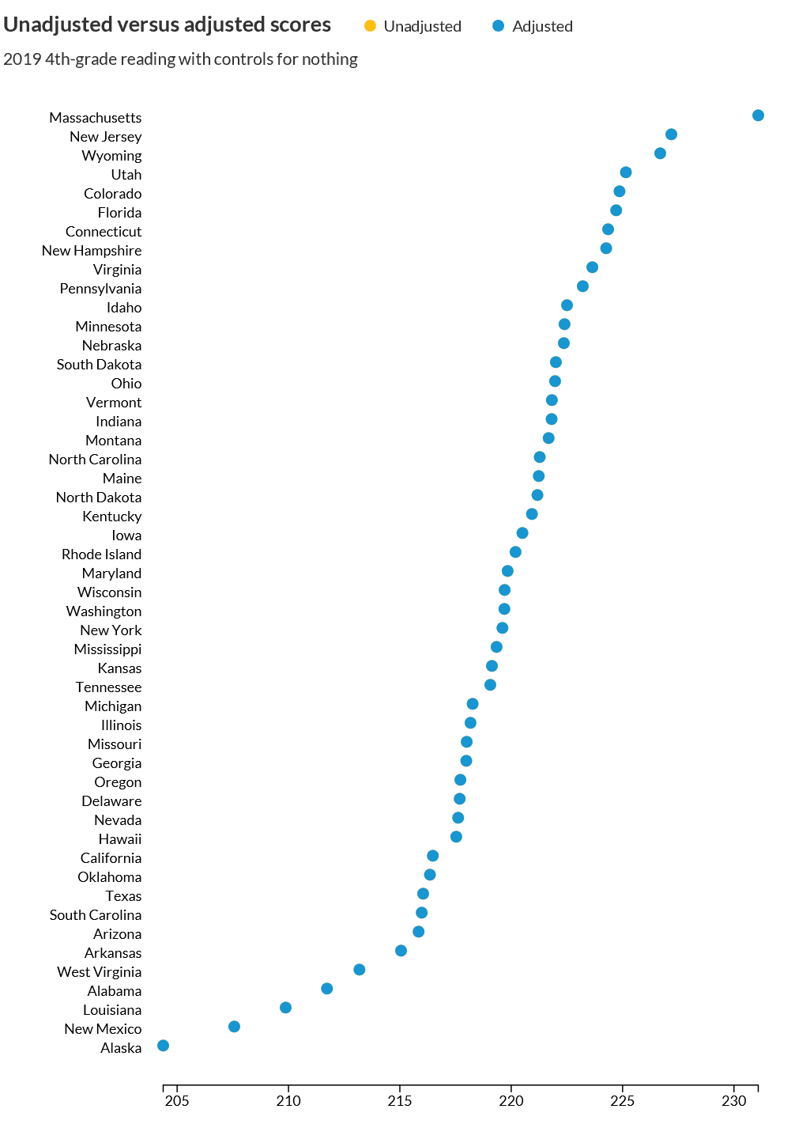

NAEP 2019 Grade 4 Reading: Race Adjusted
Notes:
http://apps.urban.org/features/naep/

Slide 22

NAEP 2019 Grade 4 Reading: Income Adjusted

Slide 23
Christy Hovanetz, Ph.D.
Senior Policy Fellow
Christy@ExcelinEd.org | 850.212.0243

Slide 24
Money is not the Answer

Slide 25
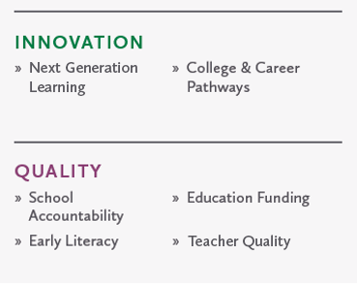
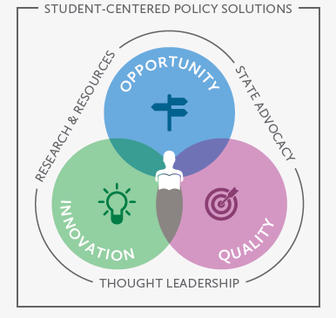
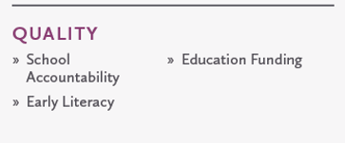

Policy changes lives
Focusing both within and outside of the traditional system, ExcelinEd advances student-centered learning policies that increase student achievement, advance equity and prepare students for college and career.

Slide 26




We convene, customize and collaborate
Our approach
Convening Thought Leaders
State-specific Research
ExcelinEd facilitates networks of states and partner organizations to inform policy, grow opportunities and improve practice.
ExcelinEd conducts research to understand how policies translate into rising student achievement, closing the equity gap, improved college and career readiness and real-world success for students.
Policy Development & Implementation
Advocating for Change
ExcelinEd supports implementation of student-centered policies, from the fundamentals of school accountability and early literacy to educational opportunity, college and career pathways and next generation learning.
ExcelinEd advocates for change in states that are ready to take the steps needed to create, expand and improve student-centered education systems.

Slide 27
K-3 Reading Fundamental Principles
Instructional Materials
District adoption of instructional materials grounded in scientifically based reading research
Teacher Supports
Statewide science of reading training for current teachers and job-embedded training and support via reading coaches
Preparing teacher candidates to have the knowledge and skill to teach all kids to read based on the science of reading
Funding and reprioritization of existing local, state and federal funds for early literacy
Assessment and Parent Notification
Universal statewide early literacy screening/progress monitoring tool
Parent notification and engagement from the beginning
Instruction and Intervention
Individual reading plans for K-3 students identified with a reading deficiency, including:
Evidence-based interventions during school, and before/after school
Summer Reading Camps
Home reading strategies or programs for parents to support literacy at home
Regularly monitor student progress and adjust instruction according to student need
Retention and Intervention
Retention for students severely below grade level (cut score matters)
Ensure one test on one day is NOT the sole determining factor (state test, alt test, portfolio)
Good cause exemptions for “some” students
Retention means more intensive interventions

Slide 28
A-F School Grades: What gets measured, gets done
A policy employed in 15 states, grading schools on an A-F scale creates a sense of urgency for excellence, heightens focus on school quality, generates community support and empowers parents with better information.
Fundamental Principles of A-F School Grades
1
5
Focus on the progress of the lowest performing students in each school
Use clear and transparent descriptors of A, B, C, D, and F
2
Include objective, concise student learning outcome measures
6
Report results as close to the end of the school year as possible
3
7
Balance measures of student performance and progress
Communicate clearly to parents
Establish rigorous criteria, with automatic increases, in order to earn an A, B, C, D or F grades
4
Calculate student progress toward grade level and advanced achievement
8
9
Use grades to identify schools for recognition, intervention, and support

Slide 29
An Era of Excuses
Education does not get enough money.
It is unfair to hold all kids to the same standards
Poverty and broken homes are to blame.
Labeling kids hurts their self-esteem
Dismal Student Achievement
Notes:
For too long, the discussion about education in America has focused on why we can’t educate our kids.
You’ve heard the excuses:
Education doesn’t get enough money. No matter what the issue, it always starts with a lack of funding. We spend more on education than any other industrialized country. If money were problem or the solution, we would have a world class education today.
It’s unfair to hold all kids to the same standards. I have heard so many people, including educators, say, We can’t expect students who are disabled or poor to learn as well as the rich suburban kids. And my personal favorite, we can’t expect students who are learning a second language to achieve at the same level as kids who grow up speaking English. The fact that these students are learning a second language - which is pretty difficult and rare in this country – should indicate that these students are, in fact, exceptional learners.
Then you have what I call the “bad parent excuse.” Poverty and broken homes are the reason kids can’t learn in school. Frankly, if we accept poverty as an excuse, we are simply perpetuating a never-ending cycle of poverty.
Finally, you hear that labeling kids hurts their self-esteem. Ironically, self-esteem may be the only area where our students don’t have any deficiencies.
The end result is dismal student achievement and anyone who buys into these excuses is committing what amounts to educational malpractice.

Slide 30
Culture of Education Reform
High expectations for all students
Rigorous academic standards
Accountability for schools
Choices for families
Rising Student Achievement
Notes:
In Florida, we ended the era of excuses and we busted a lot of commonly-held myths about education.
It starts with a bedrock belief that ALL students can learn. No excuses.
We built our reforms on that fundamental premise.
If you believe all students can learn, then we should hold all students to rigorous academic standards. How else will students achieve their potential for learning if we don’t challenge them?
If you believe all students can learn, then we should hold schools accountable for their academic success. When you take away the ability to blame the student for failure, then people organize around overcoming the challenges.
If you believe all students can learn, then we ought to let families choose the best school to ensure their success.
It is just common sense.

