Slide 1
Senate Agriculture, Rural Development and Housing – Dairy Update
Lucas Sjostrom
Executive director, Minnesota Milk
March 5, 2019

Slide 4
$0.27= 200 cow family living of $10,800

Slide 5
2018 Farm Loss Rate

Slide 6
Minnesota Dairy Farm Count: Jan 1, 2018: 3076
Jan 1, 2019: 2763
Total Loss: 313 Farms (10.2%)

Slide 7
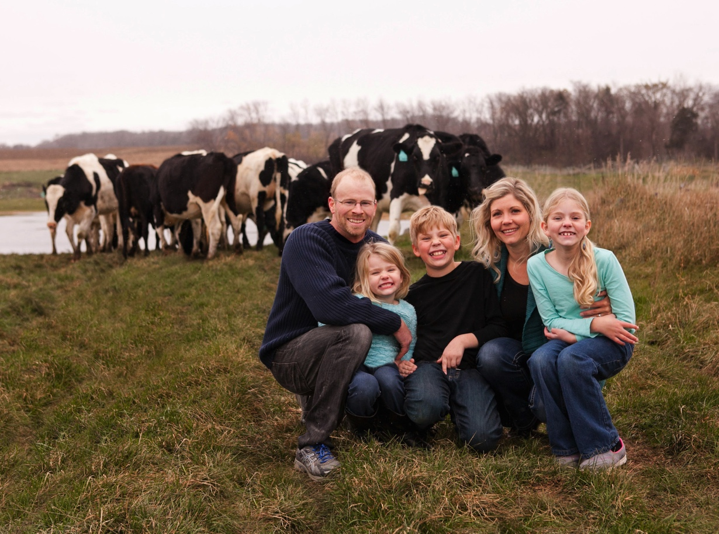
Glen & Sadie Frericks Dan, Monika, and Daphne

Slide 8
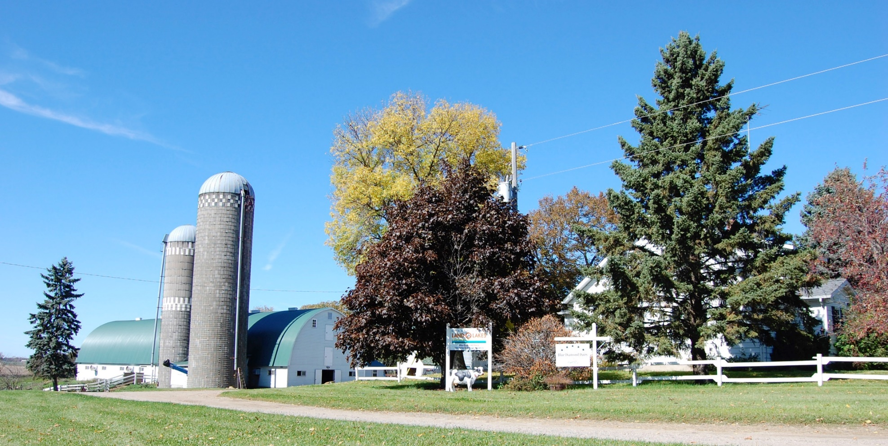
Blue Diamond Dairy www.BlueDiamondDairy.com

Slide 9
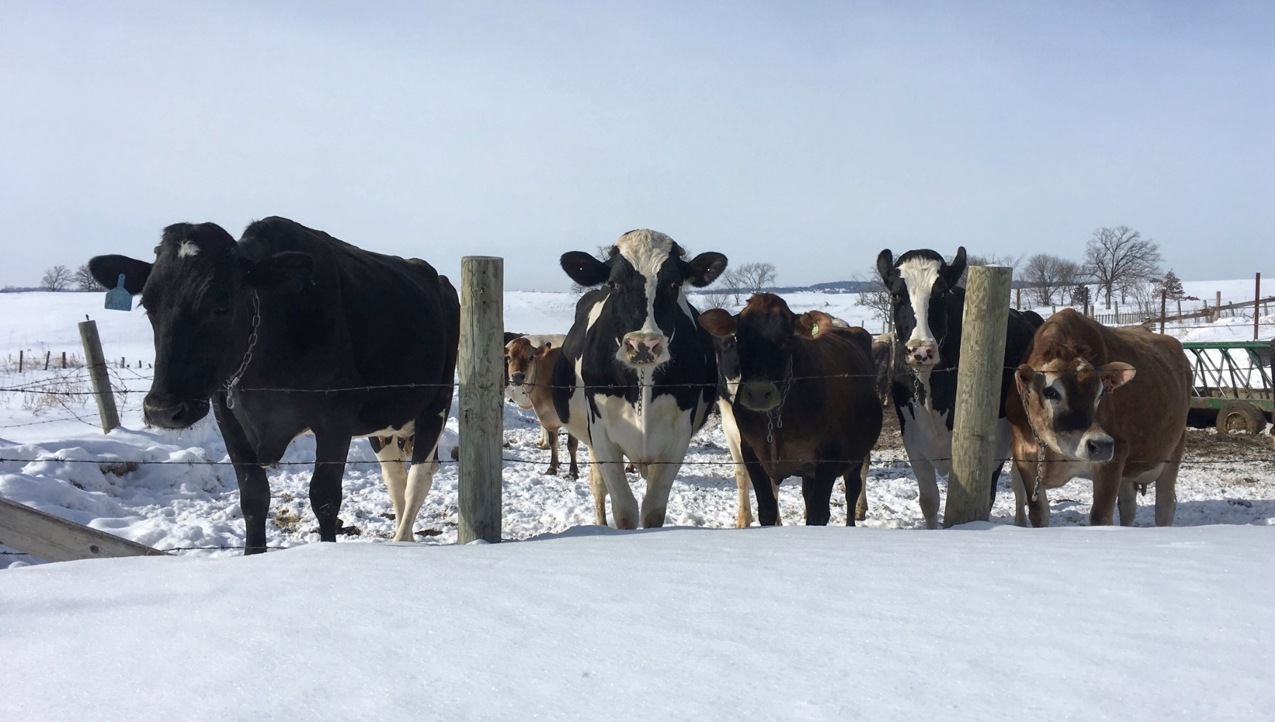
sadiefrericks@gmail.com
@dairygoodlife

