Slide 1
A NEW PATHWAY FORWARD
Minnesota's “Pathways to Prosperity”

Slide 2
The “WHAT”
We are confident that we know how to stop generational poverty, and we know what we need to do within the current system to accomplish this now.

Slide 3
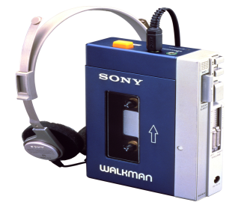

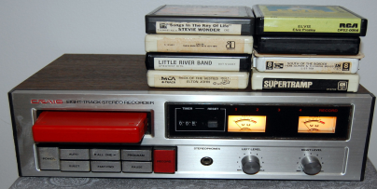




1986-2016
2017-Onward
Transportation
Individualized Universal Benefit & Services Set
TANF/SNAP
Current State
Housing
EITC
*SSM
*SSM Calculator
*Cliff Forecaster
Future State
Employment

Slide 4
The “HOW”

Slide 5
Start by viewing all work through the
Social Determinants of Health & Pillars Toward Increased Self-Sufficiency & Stability
Healthy Thriving Communities
Notes:
We know that for people to thrive, many interrelated factors all need to be in place for them

Slide 6
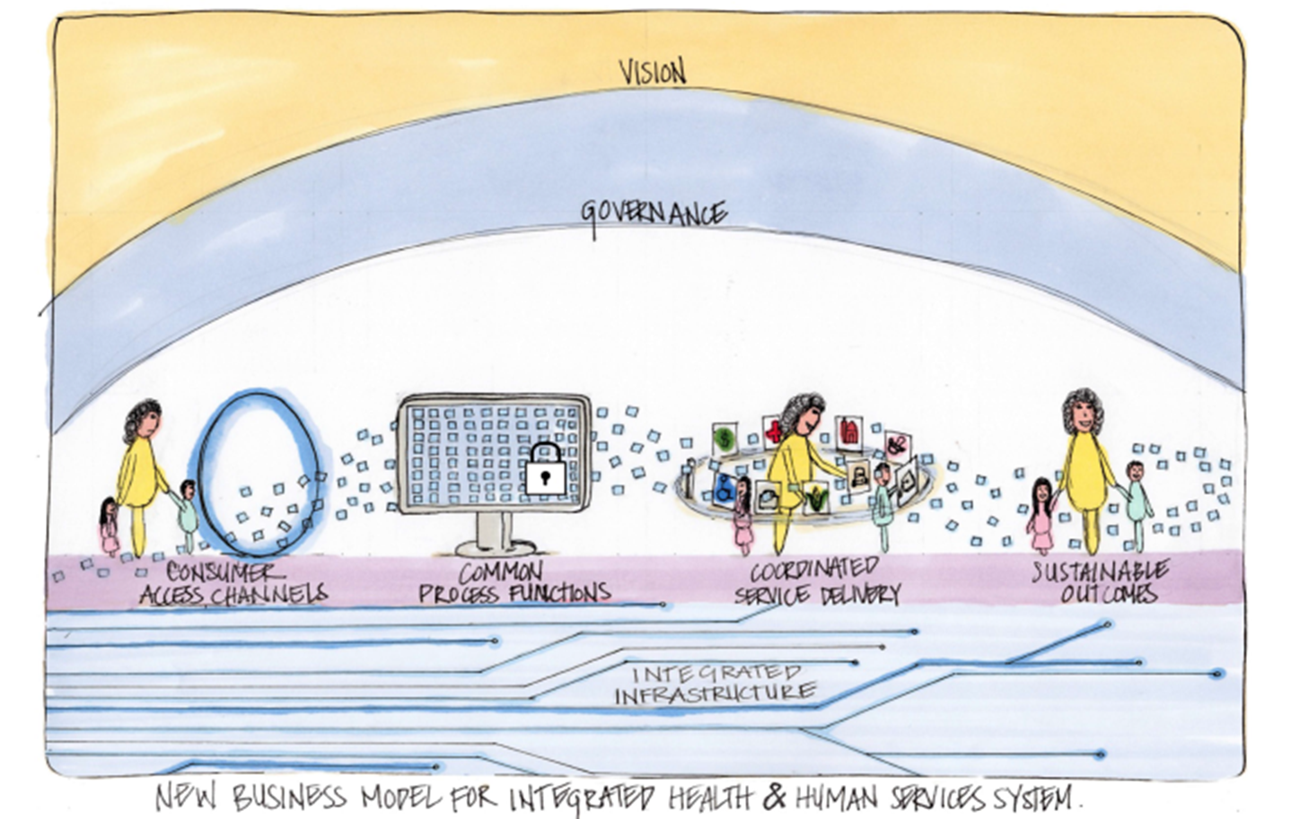
Fishbone diagrams
Identify
Assess
Respond
Manage
Measure
Data
Analytics
DeSantis
DeSantis
Notes:
This picture is a visual representation of the new business model for integrated health and human services system.
(Give overview of the model)

Slide 7
Collective Impact
Shared Goals, Strategy and Action Plan
Individual Pogroms, Policies, Rule & Regulations operating at all levels of government intending to help children and families

Slide 8
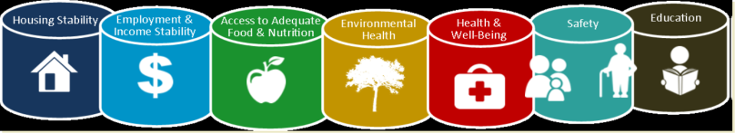
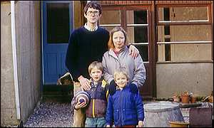
A New Pathway to Prosperity – Economic Self-Sufficiency
CORE Practice Principles To ALL INTERVENTIONS
Person-centered, Customer-centric
2 Gen approach
Trauma Informed Care
Engaged Fathers
Preventative & Strength-Based
Tools used along continuum-
*SSM Domains, SSM Calculator, Cliff Forecaster
EITC & CTC
GOAL
Target Pop.
Teen-26 yr. old w/child(ren)
Financial Empowerment
Transportation
Child Care
Health Care
Employment
Housing
Food/Cash
Education
Exit
Self-Sufficient 200% FPL & High School Graduation and/or enhanced work skills
Poverty Cavern
Notes:
*Tie workforce dollar payments to local work/industry needs report
*Maintain benefit set/amount beyond tradition exit level maybe up to 225%FPG to level off the cliff
*Start with housing, child care and Health care. Food and Cash can follow to get things launched
*Empowered consumer purchase capacity w/in TANF
*No income penalty if overall monthly income is a 225% FPG (let’s get over ourselves)
*TANF Question if we needed waivers in CCAP and TANF to stabilize clients what would that look like? Toward self sufficiency
*Housing = Flat rent or escrow (FSS) is that helpful. Match savings
*Need to remove disincentive to ^dollars and savings
*CTC = Child Tax Credit
*Need to lead with BOLD slide of “WHAT”
*We know how to stop generational poverty – we know what we need to do within the current system to accomplish this.
*Dr. Danile Brisson – research why public housing is aligned and fit for this target population
*ROI MIT for child care
*ROI – For housing First
Betsy Martins research housing support public housing by putting child care on site
*To grow wealth, you need income, stability, with kids 0-5 need to build/establish foundation
*Foundational = Housing, Child Care, Health Care, Education (welfare support is food, cash, transportation, EITC)
*Education is minimum of HS graduation and job training that equates to a minimum of 200% FPG monthly income

Slide 9
A New Pathway to Prosperity – Health & Wellbeing
Mental Health
Chemical Health
Child Welfare/JJ and Corrections
Positive Youth Development
Physical Health
GOAL
Target Pop.
Teen-26 yr. old w/child(ren)
Social/Behavioral/ Health Safety and Security
Exit
C-B mental health treatment - MHBG
Assertive community treatment – MA and 3rd party insc.
MH focused court
Crisis and domestic violence – VAWA and other SAMHSA fund sources
In patient treatment
Outpatient treatment
Drug Court
Jail Addiction Services
Co-occurring disorders treatment
Reentry Services
All SAMHSA and DOJ fund source
Re-entry
Fatherhood
Workforce Strategy
Jobs
Transition Age Youth
Mentoring
Tutoring
Healthcare access
Behavioral Health
ACF/SAMHSA/CMS/DOJ fund sources
High school wellness
Youth employment
Youth housing
Tutoring
Mentoring
Higher Education Supports
Teen Pregnancy prevention
CHIP/Medicaid
WIC/FARMS/SNAP
Health and wellness
Primary/Specialty/dental
Behavioral health
Accountable care organizations
School health
High school wellness

Slide 10

A New Pathway (BHAG) –
Enter System
Target Pop.
Exit system Self-Sufficient & Stable
Economic Self-Sufficiency
$3,422/month –
(MN ave. Monthly Cash/SANP/Housing/Child Care
Exit
Stable social/physical/emotional
Health & Wellbeing
Target Pop.

Slide 11
ACCOUNTABILITY & TOOLS PROPOSED TO ASSURE IMPACT

Slide 12
Community Services Self-Sufficiency Value Curve
“What” is needed to maximize
a successful path toward Self-Sufficiency?
Thriving
Stable
Life Span
Early Beginnings (Pre-natal – 3 yrs.)
School Readiness (Childcare – Head Start)
Education / Pre-Employment Readiness
Safe
Employment
Housing
Transportation
At-Risk
Health / Wellness/ Safety
Food
Crisis
Financial Empowerment
INTEGRATED SERVICE DELIVERY
Consumer

Slide 13
Community Services Self-Sufficiency Value Curve
“What” is needed to maximize
a successful path toward Self-Sufficiency?
Thriving
Stable
Life Span
Early Beginnings (Pre-natal – 3 yrs.)
School Readiness (Childcare – Head Start)
Education / Pre-Employment Readiness
Safe
Employment
Housing
Transportation
At-Risk
Health / Wellness/ Safety
Food
Crisis
Financial Empowerment
INTEGRATED SERVICE DELIVERY
Consumer

Slide 14
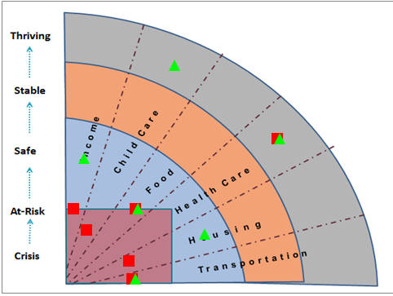
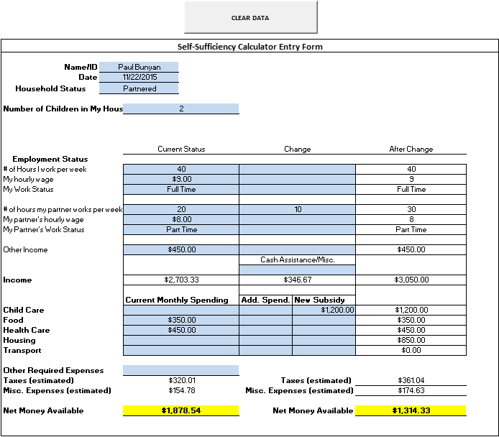

Slide 15
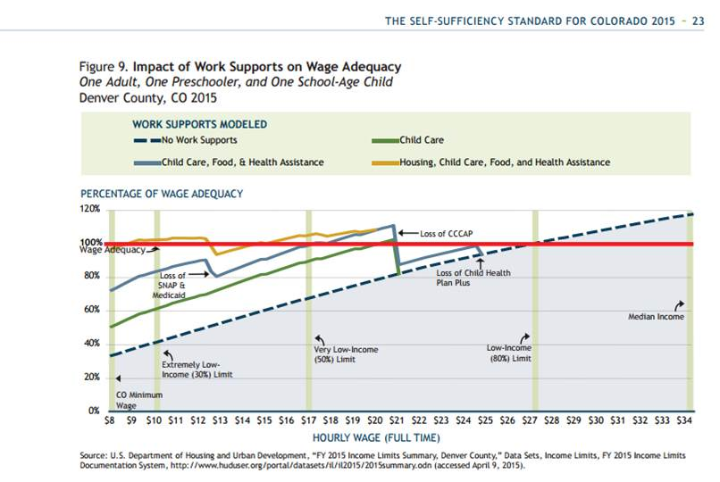
Cliff Calculator
200% FPG
225% - 250 % FPG

Slide 16
The “WHY”

Slide 17

Strategy Impact on Customers.
Stop Generational Povery
Improve customer experience – becoming more integrated, using technological tools to prevent customers from having to tell their story multiple times or losing their paperwork, etc.
Improve Access to Care through Integration and Interoperability
Apply equity lens to help mitigate disparities in outcomes and customer experience
Move intervention further upstream, assuming that when consumers are in crisis, it is more expensive to stabilize them – a stronger prevention and intervention approach

Slide 18

Greater efficiencies from integration and interoperability.
Strategy Impact on Staff.
Staff know that they can leverage services/system asset for clients from across the enterprise
Staff will not have to do dual data entry
Staff will have a master client view which will help them coordinate across services
It will ultimately lead to a better more impactful allocation of resources based on need and capacity
Established metric so staff know efforts have made a difference
Notes:
Think of the Value of our Specialty Court model – intentional, individualized and focused support.

Slide 19
QUESTIONS

