Slide 1
Assessment Without Opportunity Is Dead
Minnesota Legislative Testimony
March 14, 2018

Slide 2
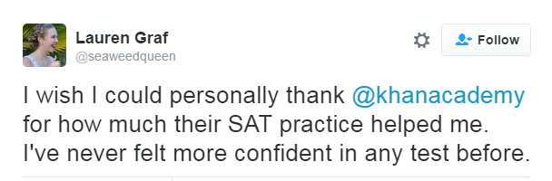
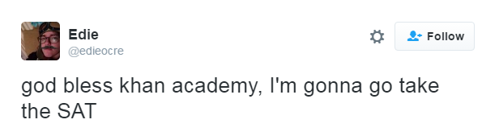

Students Answer the Call
5 million unique users
2 million linked accounts
Official SAT Practice
10% decline in commercial test prep usage
"If you don’t have money to pay for a class, you’re usually just stuck buying a book or you’re on your own mostly, so this time it was really helpful that they had unlimited resources basically for anyone.” –Maia, Washington, DC

Slide 4
Usage Is Consistent Across Demographics

Slide 5
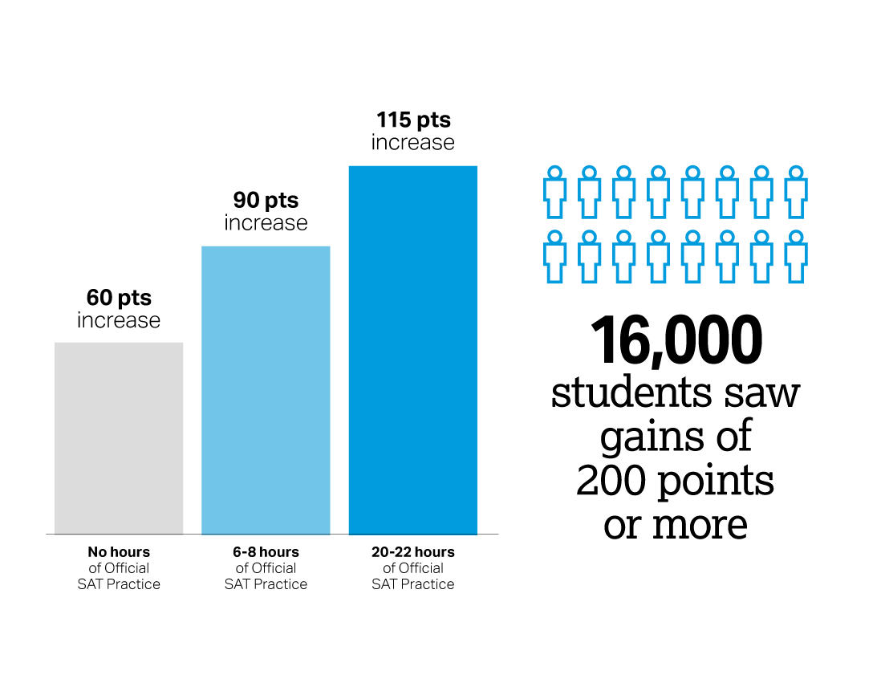
SAT Score Improvements and Official SAT® Practice
Number of points gained from
PSAT/NMSQT® to SAT correlated
to hours spent practicing
Based on 250,000 students from the Class of 2017
Practice advanced students regardless of gender, race, income, and high school GPA
Notes:
Researchers further evaluated whether the findings held across different types of students and confirmed that practice advanced students regardless of gender, race, income, and high school GPA.

Slide 6
Educators Drive Results
  School districts, community groups, and college access organizations are enabling access.
Data shows that:
Approximately 28% of Official SAT Practice usage happens during school hours.
States that administer the SAT to all high school juniors have the highest percentage of students with linked accounts
  School and nonprofit educators are leveraging the availability of free, world-class practice resources for all
Notes:
Over half of US high schools have at least one PSAT-related Assessments taker who has linked their College Board and Khan Academy accounts in order to receive a personalized study path for the SAT
States that administer the SAT to all high school juniors have the highest percentage of PSAT takers who have linked accounts as one way to get free, personalized study recommendations for the SAT

Slide 7
Upgrades
Coaching Tools for Educators
Deeper Skills Practice for ELA
Educator Best Practices
Curriculum Resources
Recently Added Features and Resources

Slide 8
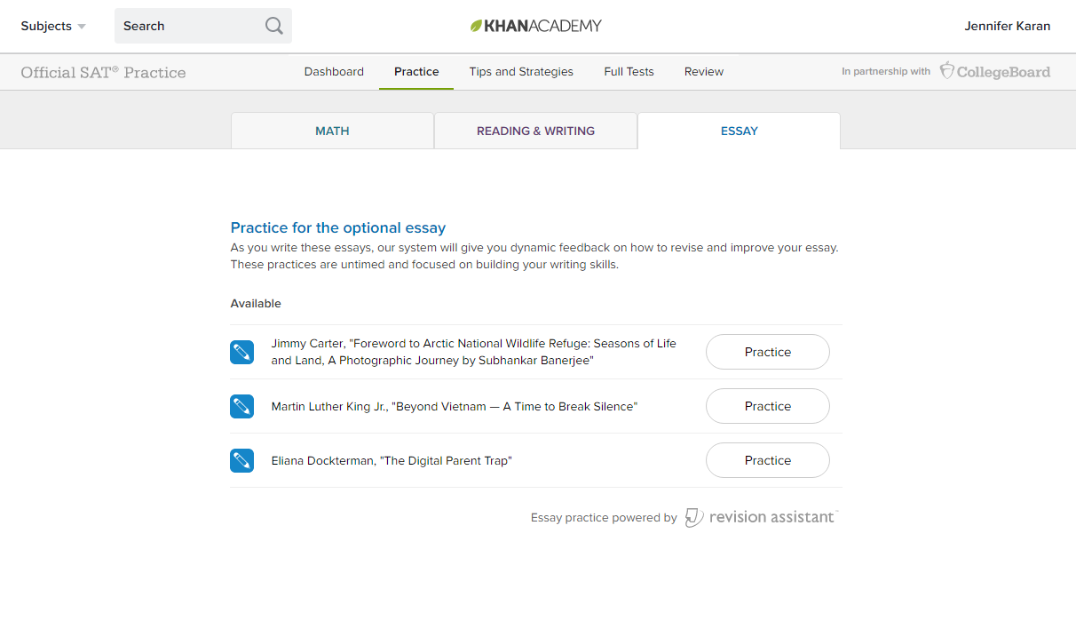
Essay Feedback
Virtual. Reliable. Instant.

Slide 9
Resources
Seven ways to get students practicing
Videos, Posts, and Tweets
Downloads
  Linking accounts
  Resources for parents, students
  Coaching/mentoring guide
satpractice.org/k12

Slide 10
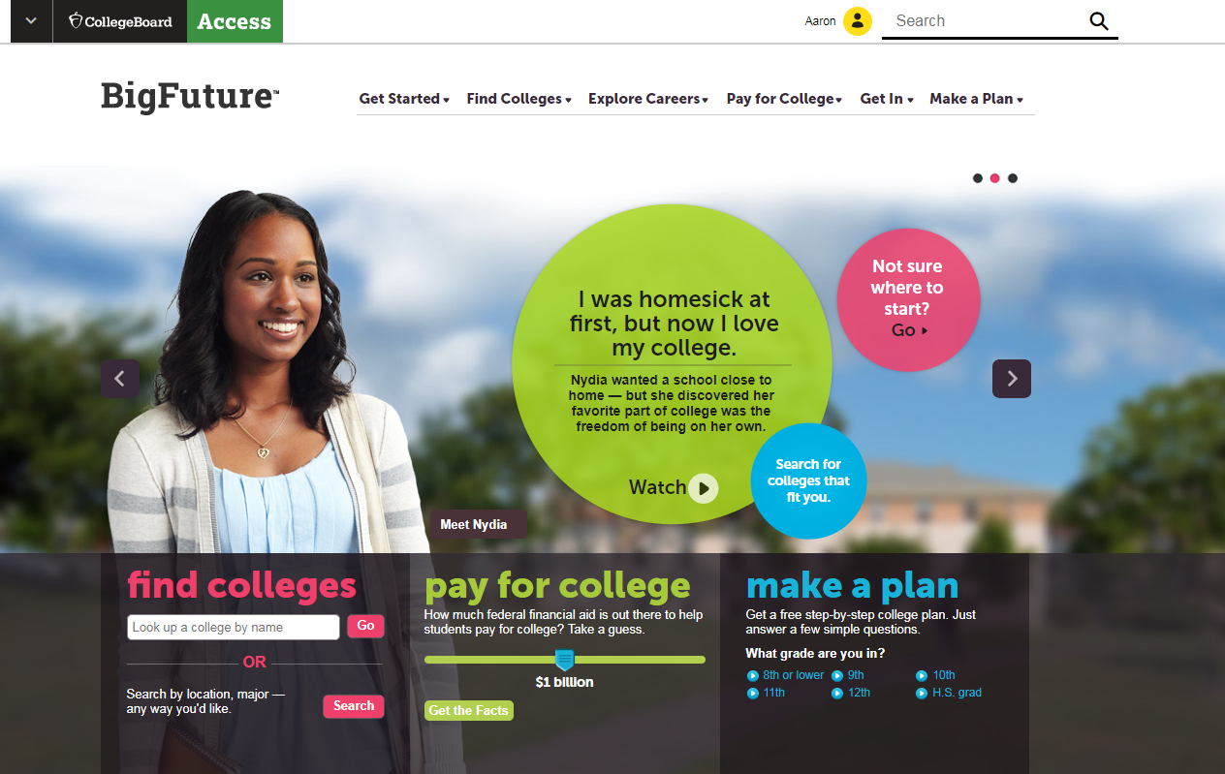
Big Future
http://bigfuture.org
Free, unbiased college search and college planning help for everyone
Over 30 million unique visitors a year
The most comprehensive database on information on colleges available

Slide 11
I think Official SAT Practice is going to give them hope. We’re calling it practice, but I think it is hope.
John Barnhill
Assistant Vice President
Florida State University

Slide 12
