Slide 1
Motor Vehicle Insurance Coverage Verification Task Force
February 2015

Slide 2
Introduction
In 2014, Minnesota Legislature established a task force to:
Review and evaluate approaches to insurance coverage verification
Recommend legislation to create and fund a program in this state
July 2014—Feb. 2015:
15-member Motor Vehicle Insurance Coverage Verification (MVICV) task force assessed processes & issues related to insurance verification
Scope expanded to include how to reduce the uninsured motorist rate

Slide 3
Background—Minnesota
Minnesota law requires drivers to:
Possess proof of insurance at all times
Maintain insurance when a vehicle is operated or when its use is contemplated
Average number of uninsured drivers:
In Minnesota, a decline from 15% in 1993, 13% in 2009, to 10.8% currently
Compared to 12.5% nationally

Slide 4
Background—Current System
KEY: Green=attest; Orange=show proof (e.g. card); Red=certificate of insurance; Blue=DVS action; *=direct contact w/ insurance company
Minnesota’s Current Proof of Insurance & Verification Process
TITLE TRANSFER
Attest to DVS to having insurance when transferring a title of a motor vehicle.
MV REGISTRATION
Attest to DVS to having insurance coverage at time of annual registration renewal.
DRIVING EXAMS
Show card to DVS: Proof of insurance must be shown at time of DVS road/skills examination.
CRASHES
Show card to law enforcement. If person does not show card, law enforcement’s accident report will indicate this to DVS. *In some cases DVS will call insurance company to verify (e.g., if requested by other state entity).
TRAFFIC STOPS
Show card to law enforcement. If person does not show card (no proof of insurance), law enforcement agency sends report to DVS. In some cases law enforcement will call insurance company to verify.
Law Enforcement IMPOUNDMENT
Show card to impound lot staff before vehicle is released.
CITATION
Law enforcement issues citation for failure to provide proof of insurance.
Person shows card to both DVS and court in 30 days; no additional action taken.
Person pleads guilty and pays fine to the court for no proof of insurance.
OR
Person fails to show card to both DVS and court in 30 days
DVS records no insurance (NI) or no proof of insurance (NPI) violation.
DVS REVOCATION NOTICE
DVS sends revocation notice telling person they have 30 days to show card to DVS and court or have driving privileges revoked by DVS.
NOTE: Most people do not go to court for this process (except to show the card to court), but a person could get a court date if they wanted to.
If driver is suspended based on information in an accident report information is given to DVS only. No court involvement.
DRIVER ACTIONS AFTER REVOCATION
To become a legal driver, the driver must complete the revocation period, submit a Certificate of Insurance/SR-22 for one year, pay a reinstatement fee, pass the written driver examination, and complete an application.
If this is the FIRST time within 5 years the driver has not submitted proof of insurance (e.g., card, policy) before a court date, the person is required to submit proof of insurance, pay reinstatement fee, pass the written driver examination and complete application for license.
If the driver has no insurance, or this is the SECOND OR SUBSEQUENT time within 5 years a driver has not submitted proof of insurance before the court date, DVS revokes the driver’s license for a period dependent on number of previous insurance violations in the last 5 years.
______

Slide 5
Background—Current System
Manual process by Dept. of Public Safety (DPS) Driver & Vehicle Services Division (DVS)
Recent trends suggest that new technologies provide an opportunity for verification process improvements
Over 30 states have electronic verification systems

Slide 6
Findings
Data is limited; lack of reliable, up-to-date data related to:
Uninsured motorist (UM) rates
Characteristics of uninsured drivers
Costs & effectiveness of various options for verifying insurance or reducing UM rates

Slide 7
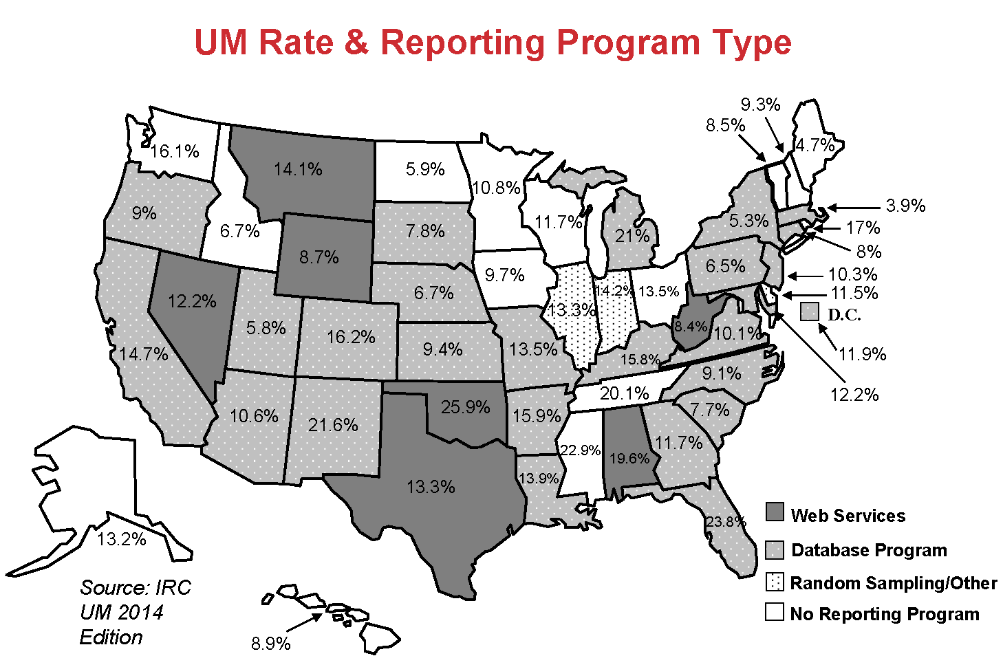
UM Rate & Reporting program Type
Web Services
Database Programs
Random Sampling/
Other
No Reporting Program

Slide 8
Findings
Many factors affect UM rates:
State’s ability to reduce UM rates depends on a wide variety of factors
No current valid data to show the importance or costs of these factors

Slide 9
Findings
No verification system will be completely accurate or lead to 100 percent compliance:
Critical to minimize errors
Acknowledge that some people will always drive without insurance
Timing is critical for Electronic Verification Program (EVP):
Study of EVP options should coincide with Minnesota Licensing & Registration System (MNLARS)
EVP cannot be developed until MNLARS is deployed

Slide 10
State trends in uninsured motorists
Minnesota
Uninsured Motorists (UM) Rate Estimate 2012
Source: 2014, Insurance Resource Council

Slide 11
State trends in uninsured motorists
Minnesota
UM State Rank 2012
Source: 2014, Insurance Resource Council

Slide 12
State trends in uninsured motorists
Minnesota
Number of UM Estimate 2012
Source: 2014, Insurance Resource Council

Slide 13
State trends in uninsured motorists
Minnesota
UM Claim Payments Estimate 2012
Source: 2014, Insurance Resource Council

Slide 14
Alternatives
Not recommended, for now:
EVP, due to required resources
Several options appeared to be easy solutions, but with further investigation, determined to be infeasible or not desirable for the state
Examples: DWI-style plates for vehicles of insurance violators; various fine options

Slide 15
Recommendations Overview
The task force recommends a comprehensive approach to addressing the UM problem in Minnesota
Approach includes possible implementation of an electronic verification system

Slide 16
Recommendation 1
DPS should strengthen its proof of insurance requirements and processes.
In all DVS transactions, require three additional pieces of information as proof of insurance
insurance company name
policy number
expiration data
People who now attest to coverage at vehicle registration and vehicle renewal must show proof of insurance

Slide 17
Recommendation 2
State should increase penalties for people who are convicted of driving without insurance or without proof of insurance.
Ask the Judicial Council to consider removing “no insurance” and “no proof of insurance” offenses from the Statewide Payables Lists, in order to require insurance violators to go to court
Fines could be more than triple if the maximum fine were assigned by a judge

Slide 18
Recommendation 3
State should implement a public awareness program to support new processes and promote compliance with the compulsory insurance law.
Minimize disruption to the public with the introduction of additional proof requirements at registration
Emphasis on penalties, including fines and license suspensions

Slide 19
Recommendation 4
Ongoing committee or advisory council should be created to help implement the task force’s recommendations.
Assist the state in developing effective policies
Establish goals
Direct activities
Measure and analyze data, including the effectiveness of EVP in other states and the effect of Minnesota policy changes

Slide 20
Recommendation 5
State should reassess EVP’s expected benefits, costs and implementation issues
After MNLARS is deployed and operational
Results of stronger proof of insurance requirements are known (Recommendation 1)
State implements Recommendations 1–3
EVP in other states has evolved

